Slide 1
Medical Student Educator Awards
Curriculum Colloquium 2024

Slide 2
Awards Committee
Thuy Bui
Raquel Buranosky
Alda Gonzaga
Paul “Kip” Kinchington
Cynthia Lance-Jones
John Maier
Robin Maier
Jason Rosenstock
Richard Steinman
Steve Truschel
Eloho Ufomata
Evan “Jake” Waxman
Bill Yates
MS3: Georgann Booth
MS4s: Sharon Ashok, Nikita Desai
Nominations
74

Slide 3
ALL who teach contribute
to our educational mission
Many, many excellent educators will not be honored today
Education: a team process
Residents/fellows teach too
Other award opportunities

Slide 4
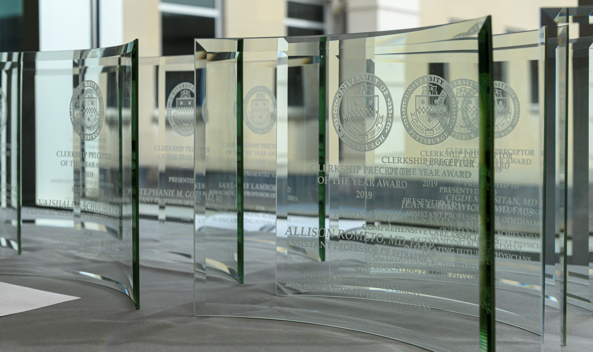

Slide 5
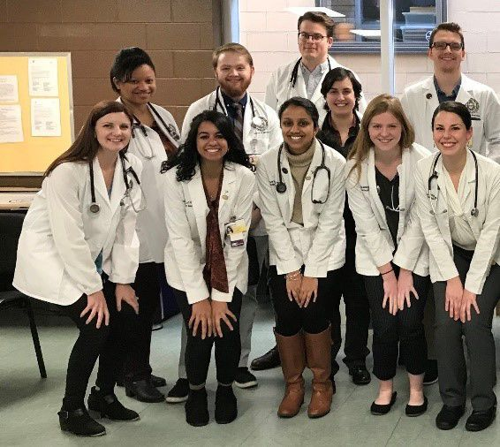
UPSOM Education Awards
Distinguished Service in Medical Education Award
Kenneth E. Schuit Award
Sheldon Adler Award for Innovation in Medical Education
Donald S. Fraley Award for Medical Student Mentoring
William I. Cohen Award for Excellence in Clinical Precepting
Social Justice Education Award
Outstanding Staff Contributions to the Curriculum
Outstanding Medical Student Contributions to the Curriculum
Early Career Educator Award
Excellence in Clinical Precepting
Clerkship Preceptors of the Year
Carl R. Fuhrman Clinical Educator of the Year
Award for Outstanding PEC
Excellence in Education Awards [MS1-2]

Slide 6
Excellence in Education Awards
At the end of their first and second years, medical students at UPSOM recognize faculty educators for their valued contributions and dedication to teaching in the Foundations of Medicine (FOM) and Organ Systems Pathophysiology (OSP) courses.

Slide 7
MS1 Curriculum
Course Directors: Drew Klein, MD and Allie Dakroub, MD, MS, FAAP, FACP
Lecturer: Martin Schmidt, PhD
Facilitator: Joe Suyama, MD, FACEP

Slide 8
MS2 Curriculum
Course Director: Jenifer Lee, MD
Lecturer: Joshua Levenson, MD
Facilitator: Louis Rapkin, MD

Slide 9
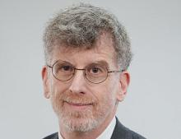
Dr. Robert Arnold
Distinguished Service Professor of Medicine
Medical Director, UPMC Palliative and Supportive Institute
Co-Lead, Longitudinal Educator Program (3RC)

Slide 10
Outstanding Professional Enrichment Course
Background:
Established 2014
Honors PECs (formerly mini-electives) in MS1-2
Exploration/growth outside traditional curriculum
Past Winners:
DeKosky, King, Reitschuler Cross, Israel, Suyama, Sultan, Veldkamp, Chang, Tobias, McDowell, etc.
And this year’s winners are….

Slide 11
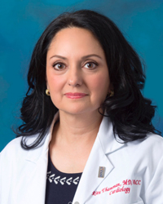
Outstanding Professional Enrichment Course
Culinary Medicine
Ritu Thamman, MD, FASE, FACC
Medicine
16 MS2 students annually for the past three years
Adapted to COVID restrictions
Made continuous improvements in response to student feedback
Garnered outstanding teaching evaluations with 91% (20/22) of post-course survey respondents

Slide 12
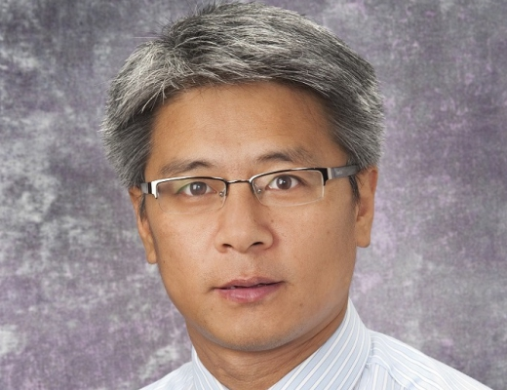
Outstanding Professional Enrichment Course
AI in Medicine
Shandong Wu, PhD
Radiology, Biomedical Informatics, Bioengineering, Intelligent Systems, Clinical and Translational Science
Served as a committee member of the AI Task Force
Sees AI education for medical students and trainees as an important component of his mission to facilitate AI innovations in medicine.
Exploring a formal master degree program on AI-in-Medicine

Slide 13
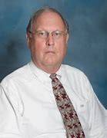
Carl R. Fuhrman Clinical Educator of the Year Award
Background:
Established 2008
Honors faculty who teach in clinical elective courses (MS3-4)
Past Winners:
Vargo, Schott, Thurston, Thamman, Shenai, Nowalk, Sgro, Tilstra, DiNardo, etc.
And this year’s winners are….

Slide 14
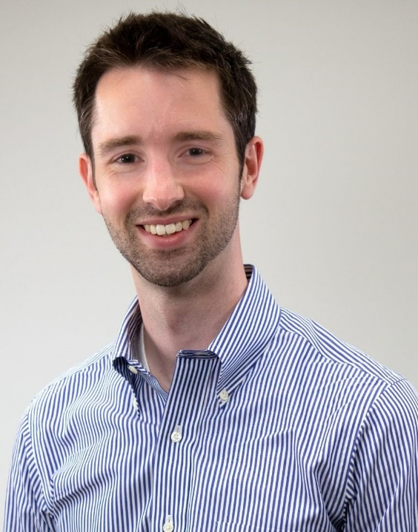
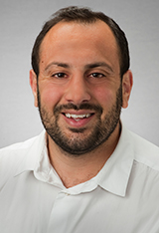
Carl R. Fuhrman Clinical Educator of the Year Award
Allie Dakroub, MD, MS, FAAP, FACP
& Drew Klein, MD
Medicine
For Elective “Principles of Medical Education”
4-week PriME elective recruits on average, 20 students and 20 residents yearly
Serve as wonderful examples of innovation in medical education
Passionate about medical education
--"(Instructors) provided thoughtful and useful feedback. Always available and approachable. Very invested in learners."

Slide 15
Clerkship Preceptor of the Year Award
Background:
Established 2006
recognizes faculty clinical preceptors who consistently provide outstanding clinical instruction in the clerkship setting
Past Winners:
Biller, Cohen, Van Cott, Cunningham, Vanderberg, Hayes, Schuchert, Kettel, Choi, Serra, Knepper, etc.
And this year’s winners are….

Slide 16
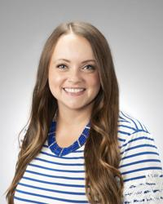
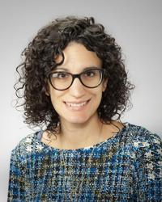
Clerkship Preceptor of the Year Award
Brielle Spataro, MD, MS
Medicine
High teaching effectiveness scores
“Clear expectations, consistent feedback, and enthusiastic teaching”
“Safe learning environment on the wards and in clinic”
Many call her their favorite preceptor and the highlight of their clerkship.
Amanda Casagrande, MD
Family Medicine
“Supportive, thoughtful and inspiring preceptor”
“Clear expectations for notes, presentations, and workflow. She showed interest in teaching and did so throughout the day as time allowed."
"Dr. Casagrande was so kind, patient, and supportive of me... I am so grateful to have had the opportunity to learn from her!"

Slide 17
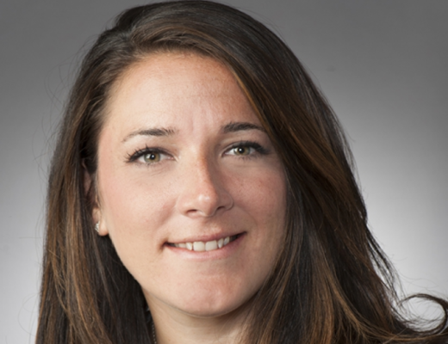
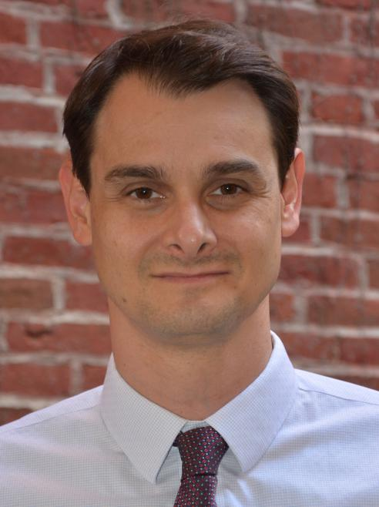
Clerkship Preceptor of the Year Award
Elizabeth Sensenig, MD, FAAP
Pediatrics
Consistently recognized by students as a standout preceptor
Creates a safe learning environment
Offers a wonderful balance of autonomy and support
“So many strengths”
“Favorite preceptor to date”
Justin Shuster, MD, MPH
Psychiatry
“Loved every minute of my time on this clerkship thanks to him”
Supportive of accommodations
Made students feel comfortable and part of a team
“Great sense of humor”
Fostered a great learning environment

Slide 18
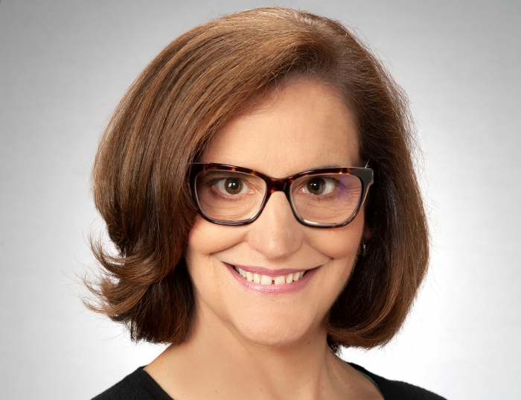
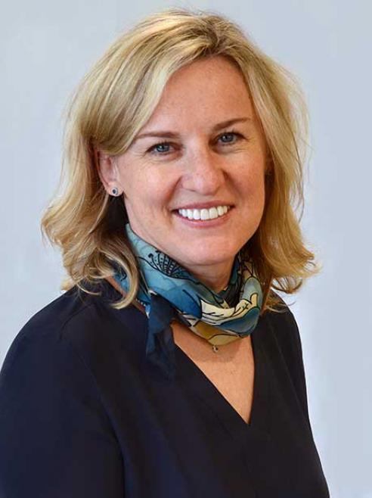
Clerkship Preceptor of the Year Award
Kathleen Ober, MD
OB/GYN
Provides years of clinical experience to patients by providing expert inpatient obstetrical care.
“Incredibly welcoming”
“Fantastic teacher”
“One of the best attendings with whom I have worked across any clerkship”
Laima Spokas, MD
Psychiatry
Provides inclusive environment for students
“Excellent teacher during the entire rotation”
“Willingness to include students in all aspects of care”
“My favorite rotation!”
“A warm, inclusive, thorough teacher”

Slide 19
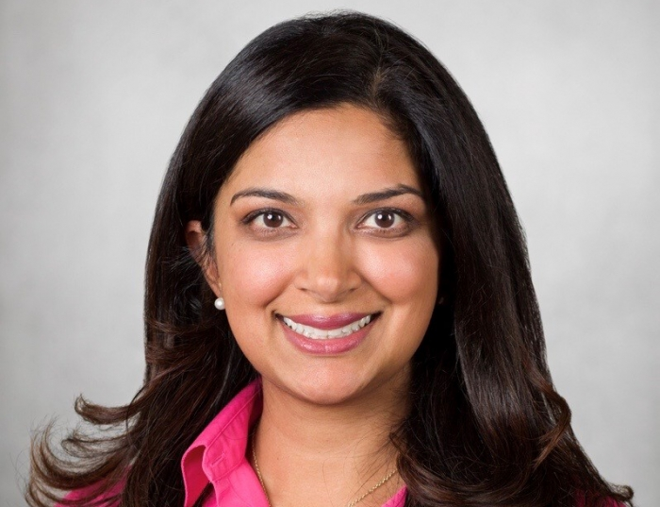
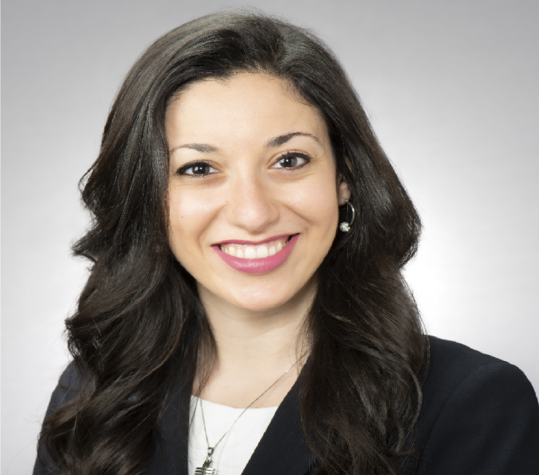
Clerkship Preceptor of the Year Award
Pritha Workman, MD
OB/GYN
“Continually learned so much from her”
“Made honest and helpful feedback a priority”
Always helped students with topics they were struggling with, even while working on a 24 hour shift
“Very committed to teaching”
Rachel Ibrahim, MD
Emergency Medicine
Key educator for the Specialty Care Clerkship
“Provides guidance and supervision”
“Outstanding essential educator in the clinical setting”
Core faculty member teaching suture skills to the students each month

Slide 20
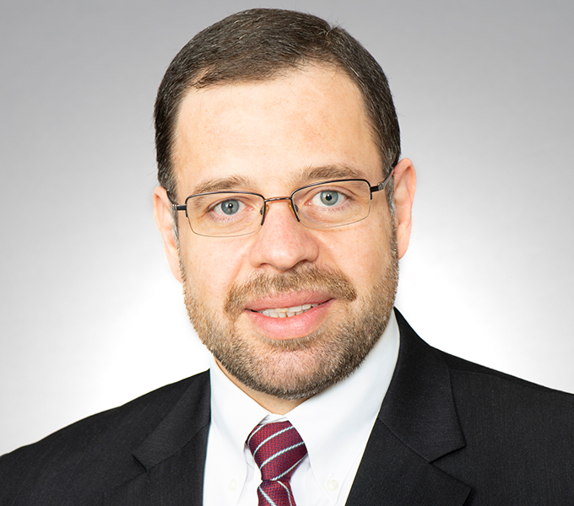
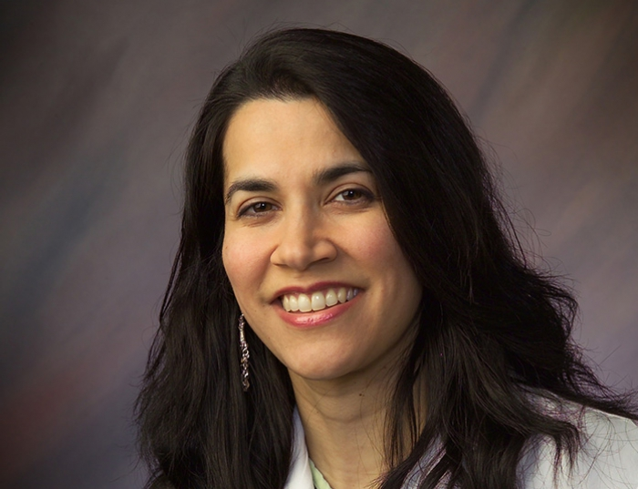
Clerkship Preceptor of the Year Award
Tawfiq Al-Lahham, MD
Neurology
Teaches in all aspects of Neurology Clerkship and frequently volunteers for additional activities
“Great teacher; extremely involved”
“Very generous with time and dedication to students’ learning”
“Effective style of teaching”
“Appreciated his patience and overall enthusiasm”
Vaishali Schuchert, MD
Surgery
“Spear-headed a substantial transformation of the Surgery Clerkship’
Highly committed to medical students, the clerkship, and Medical School Mission
“Organized, insightful, and innovative”
“Energy and commitment are truly inspirational”

Slide 21
Award for Excellence in Clinical Precepting
Background:
Established 2004
recognizes faculty who consistently provide outstanding clinical instruction in a community setting
Past Winners:
Wahba, Chu, Holst, Busis, Butler, Sauereisen, Weinkle, Zimmerman, etc.
And this year’s winners are….

Slide 22
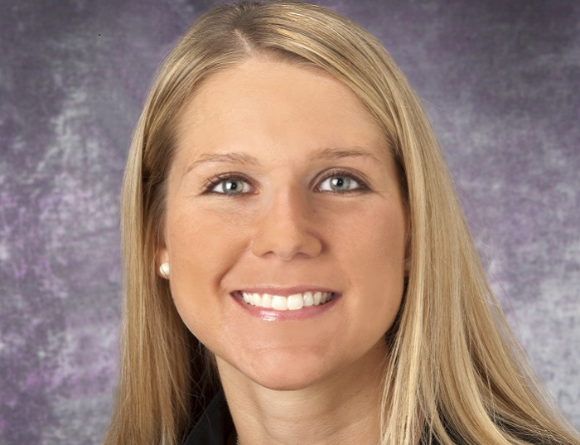
Award for Excellence in Clinical Precepting
April Dunmyre, DO
Obstetrics, Gynecology and
Reproductive Sciences
Has served as Assistant Clerkship Director over the past 1.5 years
“Does it all – clinic, major surgical cases, and obstetrical call”
“Provides valuable stability”
“Takes time to precept both in clinic and operating room”
Currently has 100% rating from students

Slide 23
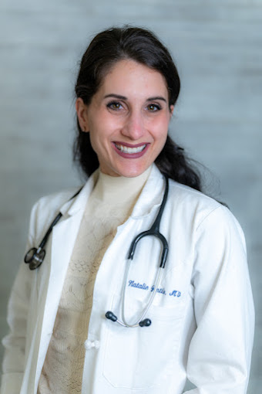
Award for Excellence in Clinical Precepting
Natalie Gentile, MD
Family Medicine
Teaches FM didactic sessions
“Teaches medical students with enthusiasm and creativity”
“Gives insight into broad spectrum Family Medicine and Lifestyle Medicine”
Rated as among the best of preceptors

Slide 24
Outstanding Early Career Educator Award
Background:
Established 2017
meant to honor junior faculty who have demonstrated excellence and promise as educators in the UPSOM curriculum
Past Winners:
Vanderberg, Dakroub, Klein, Szymusiak, Ufomata
And this year’s winner is….

Slide 25
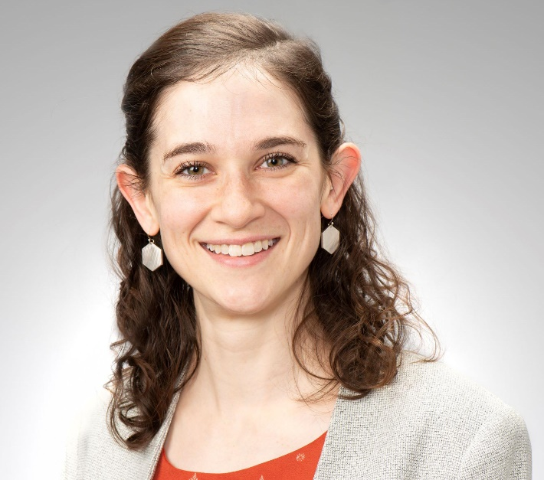
Outstanding Early Career Educator Award
Lydia Strattan, PhD
Pathology
Incredible faculty lead for Anatomy within 3RC
Created intentional coursework design and structured lab instruction
Went from 8 weeks (legacy) to 3 weeks of Anatomy – was able to ensure students receive the most critical information
Built trust with students
Receptive to student feedback
Achieved outstanding success as an instructor

Slide 26
Outstanding Staff Contributions to the Curriculum
Background:
Established last year
recognizes a current staff member (or team) at any level who has demonstrated leadership and excellence in improving the curriculum at the University of Pittsburgh School of Medicine.
Past Winners:
Marlynn Haigh; Greg Null
And this year’s winners are….

Slide 27
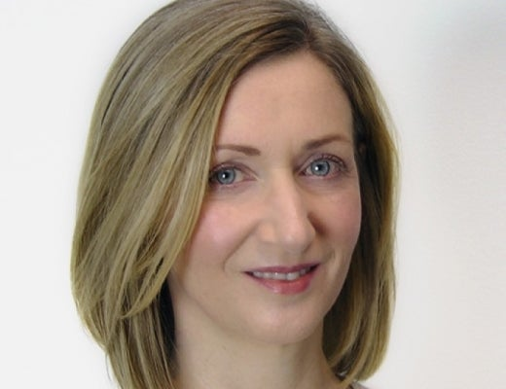
Award for Outstanding Staff Contributions to the Curriculum
Denise Downs
OMED
Coordinator for Get Ready for Residency Boot Camp
Has 120-150 students and is a logistical juggernaut
Extremely organized and handles chaos well
“Great reliability while maintaining a smile and calm attitude without complaint or hesitation.”
“Glue that holds Boot Camp together”
Willingness to help her coworkers in OMED
“Consistent, competent, and talented”

Slide 28
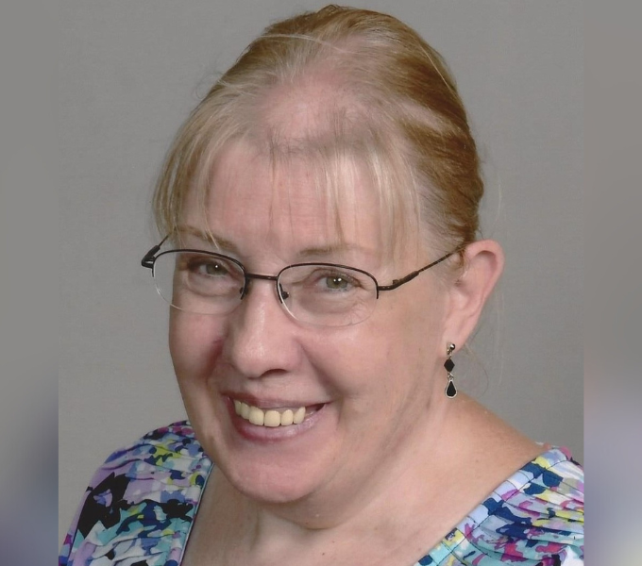
Award for Outstanding Staff Contributions to the Curriculum
Patti Zahnhausen
Family Medicine
Coordinates with “integrity, grace, hard work, and excellence”
“Strives to make sure learning experiences are professional, feasible and well done”
Heading towards retirement and will be greatly missed
Has supported Family Medicine for more than 15 years and many years before that in OMED
“Keeps faculty on-task and on-time in a respectful manner”
Provides helpful tips, supports students, and serves as a mentor to many

Slide 29
Outstanding Medical Student Contributions to the Curriculum
Background:
Established 2021
recognizes a current medical student (or team of students) at any level who has demonstrated leadership and excellence in improving important aspects of the UPSOM curriculum
Past Winners:
Sabina Spigner & Rachel Fogel
And this year’s winner is….

Slide 30
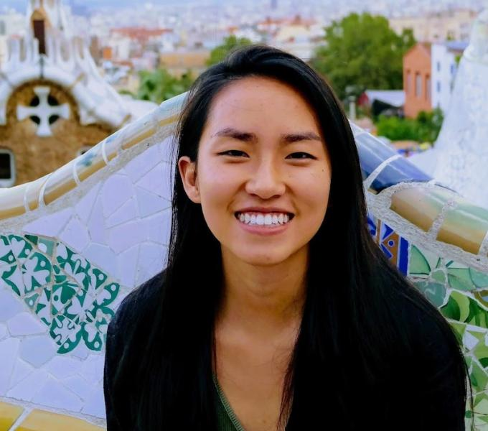
Award for Outstanding Medical Student Contributions to the Curriculum
Nathalie Chen
MD/PhD Candidate
Exemplary leadership within the curriculum reform process over the past two years.
Student lead
Helped implement collaborative-based learning (CBL)
Has the ability to take vision and make it a reality
Continually represents the students
“Well-prepared, excellent listener, and completely unflappable”
“Continues to be an active member of our medical school and a kind and honest face of the new curriculum development”

Slide 31
Social Justice Education Award
Background:
Established 2020
recognizes faculty who have demonstrated excellence in teaching social justice—e.g., anti-racism, social determinants of health, care for sexual and gender minorities, etc.
Past Winners:
Tripp, Bui, McCormick, James
And this year’s winners are….

Slide 32
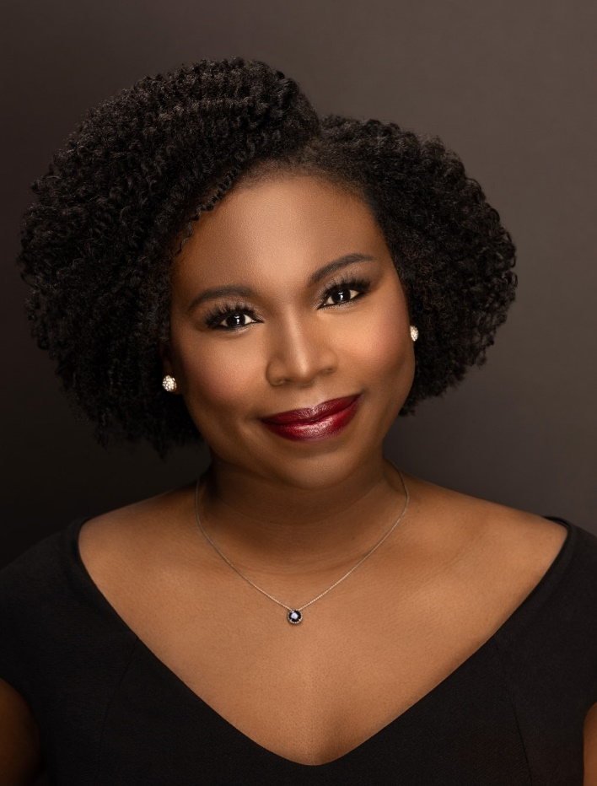
Social Justice Education Award
Eloho Ufomata, MD, MS
Medicine
Created the FEB Challenge
“Natural skills as an educator and has blossomed into an outstanding scholar and leader”
Passionate about promoting diversity, equity, and inclusion
Mission is to better incorporate social medicine in the medical school curriculum
Created several opportunities for faculty development and curriculum improvements
Advisory Dean to about 100 medical students
“Leader among leaders”
A shining star!”

Slide 33
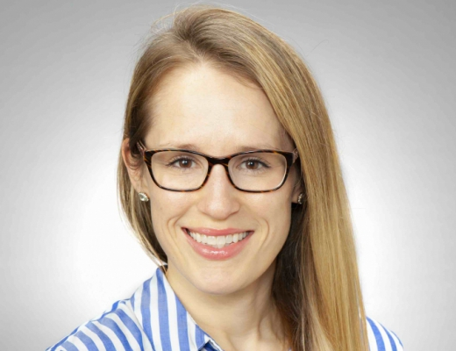
Social Justice Education Award
Katharina Hayes, MD
Pediatrics
“Been a leader and trailblazer in teaching students”
Led the creation and implementation of an antiracism workshop
Work was recognized at the 2022 Med Ed Day
“I really appreciated Dr. Hayes’ emphasis on social medicine and social justice rounds”
Creates a safe and nonjudgmental environment
Students self-reported comfort on topics such as racism significantly increased due to Dr. Hayes efforts

Slide 34
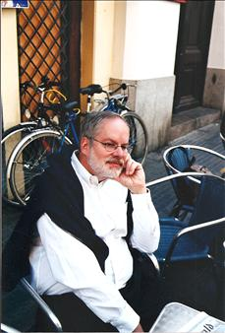
William I. Cohen Award for Excellence in Clinical Skills Instruction
Background:
Established 2008
recognizes faculty who consistently provide outstanding clinical skills instruction for first and second year UPSOM medical students.
Past Winners:
Tavarez, Shah, Rossiter, Herrle, King, Spagnoletti, Van Deusen, Reis, Arnold, Lamberty, etc.
And this year’s winner is….

Slide 35
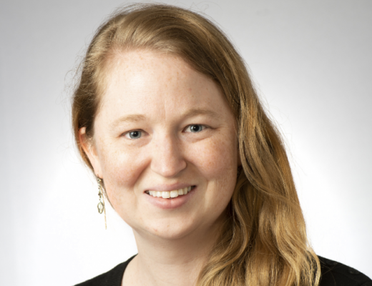
William I. Cohen Award for Excellence in Clinical Skills Instruction
Erin Cummings, MD
Pediatrics
Led the return to in-person sessions, which was well-received by students.
Enthusiastically taken on the role of a Clinical Skills Preceptor in 3RC
Average score of 4.87/5 for overall teaching effectiveness
“Incredibly helpful as a teacher”
“Cares about students’ development, which was both motivating and truly helpful

Slide 36
Donald S. Fraley Award for Medical Student Mentoring
Background:
Established 2002
recognizes individuals for their outstanding contribution to medical education through their service as mentors to medical students
Past Winners:
Abel, Hamad, Gonzaga, Douaihy, Gonzalez, Steinman, Bui, McIvor, Waxman, etc.
And this year’s winner is….

Slide 37
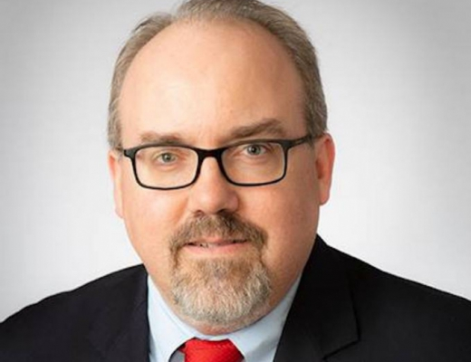
Donald S. Fraley Award for Medical Student Mentoring
Andrew Nowalk, MD, PhD
Pediatrics
Faculty member since 2006
Served as an invaluable mentor
Served as a FAST Advisor and Advisory Dean in which he had over 150 students.
“Sounding board for me from a career development perspective for 10 years”
“Reliable and kind to talk to, even with personal matters”

Slide 38
Sheldon Adler Innovation in Education Award
Background:
Established 2002
recognizes innovation in medical education
Past Winners:
Donovan, Tobias, Douaihy, Kohli, Oddis, CSCS, Chiarchiaro, J. Maier, Pacella, Roth, etc.
And this year’s winner is….

Slide 39
Sheldon Adler Innovation in Education Award
Amanda Casagrande, MD
Family Medicine
Active leader and Director of the Primary Care Accelerated Track
Strong leadership and ability to innovate
Willingness to serve and confident in her ability to build PCAT from scratch
“Goes above and beyond to develop new models and processes for PCAT students”
“Innovative, talented, and strong spirit”
Continually working to expand program
“Great teacher, mentor, and colleague”

Slide 40
Kenneth E. Schuit Award
Background:
Established 2000
Honors faculty for education-related contributions
Dean’s Master Educators
Past Winners:
Schott, Lance-Jones, Eibling, Powers, Drain, DeFranco, J. Lee, Painter, Elnicki, McIntire, etc.
And this year’s winner is….

Slide 41
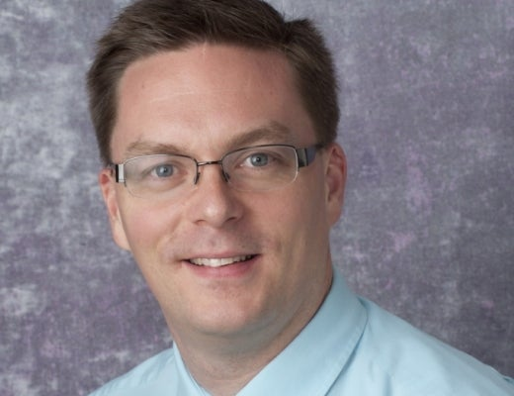
Kenneth E. Schuit Award
Reed Van Deusen, MD, MS
Medicine
“Vital member of the UPSOM community”
His success as the leader of the SP Program was nationally recognized through the Educational Program Development award; highly prestigious and competitive award
“Commitment to education of medical students is unparalleled”
IMI was and continues to be highly rated by students
Leadership continues to exponentially grow
Committed to continuous quality improvement and innovation

Slide 42
Distinguished Service Award
Background:
Established 1998
the highest honor in medical education given by the UPSOM, for high achievement, significant administrative responsibilities, and dissemination
Past Winners:
Only 11 honored in 24 years
Lance-Jones, Kanter, Granieri, South-Paul, McNeil, Schumann, etc.
And this year’s winner is….

Slide 43
Ann Thompson, MD, MCCM, MHCPM Distinguished Service Professor, Critical Care Medicine and Pediatrics Vice Dean, University of Pittsburgh School of Medicine

Slide 44
UPMC Children’s Hospital of Pittsburgh
Clinician
Groundbreaking Medicine
Teacher
Mentor
Liver Transplant
Parental Support
Sponsor
Leadership
Chef
Research
President of SCCM
Division Chief
Program Director
Women
Notes:
Division leader, program director, interim chair of our department, clinical affairs,
Teacher, bedside, didactics
Mentor to all fellows, leadership, education, women
Parental support- not only while in the PICU, lifelong relationships with parents and families

Slide 45
University of Pittsburgh School of Medicine
DEI
Empowering Women
ELAM
Clinician Educators
Sponsor
Advisor
Leadership
Mentor
Promotions
Kazakhstan
Social Justice
Faculty Affairs
New Curriculum
Chef
Notes:
Division leader, program director, interim chair of our department, clinical affairs,
Teacher, bedside, didactics
Mentor to all fellows, leadership, education, women
Parental support- not only while in the PICU, lifelong relationships with parents and families

Slide 46
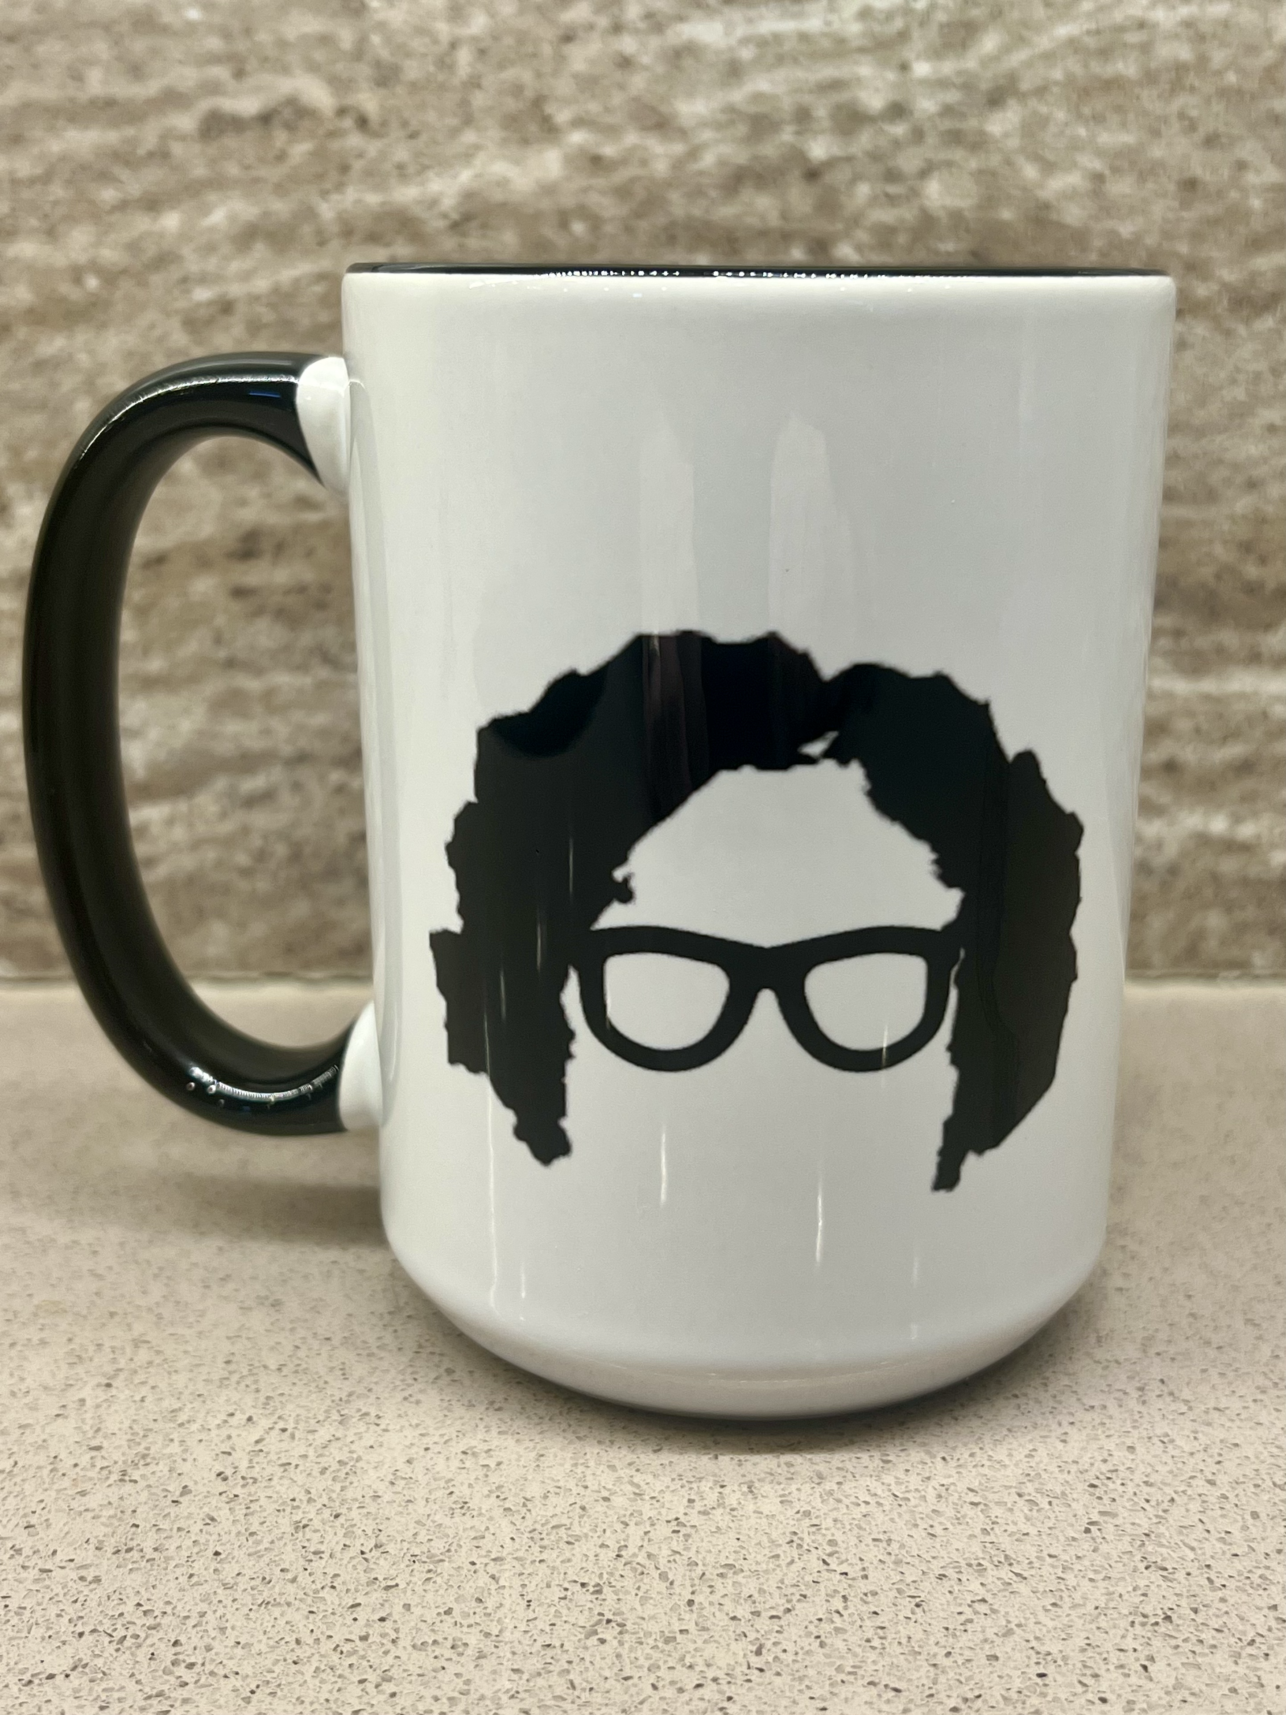

Slide 47
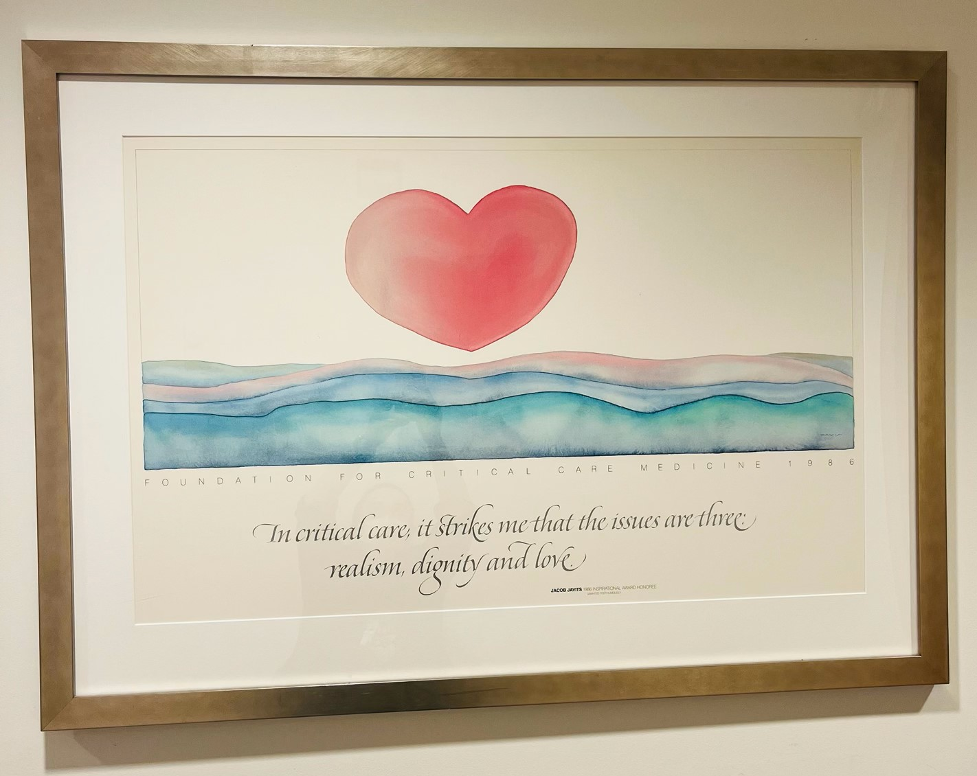

Slide 48
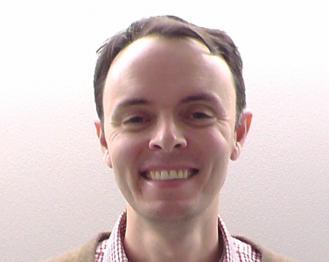
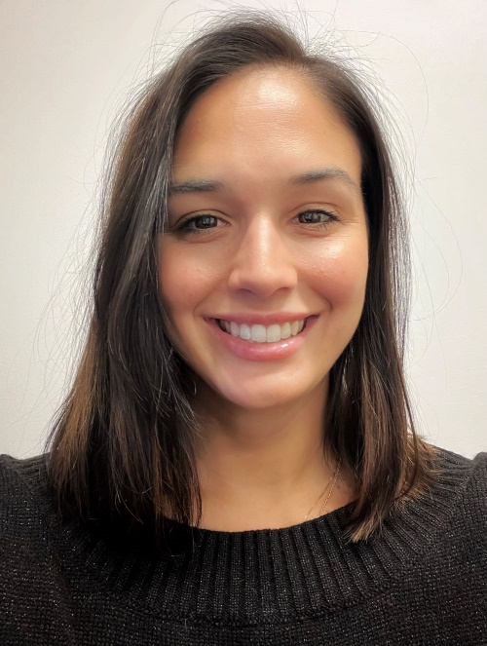
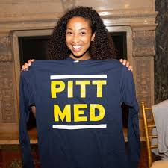
Greg Null
Michelle Sergent
Health Sciences IT Team
THANKS!!!!!

