Slide 1
The 28th Curriculum Colloquium
University of Pittsburgh School of Medicine
February 9, 2023

Slide 2
Why are We Here
The What to the Why to the HOW

Slide 3
Who are WE?
Contributors to the Learning Environment
Patients
Other Trainees
OSA
OMED
STUDENTS
Faculty
OUTSIDE LIFE, Personal Things
OLE
Staff
Community
DEI

Slide 4
Our Learning Environment Golden Circle
WHAT
HOW
WHY

Slide 5
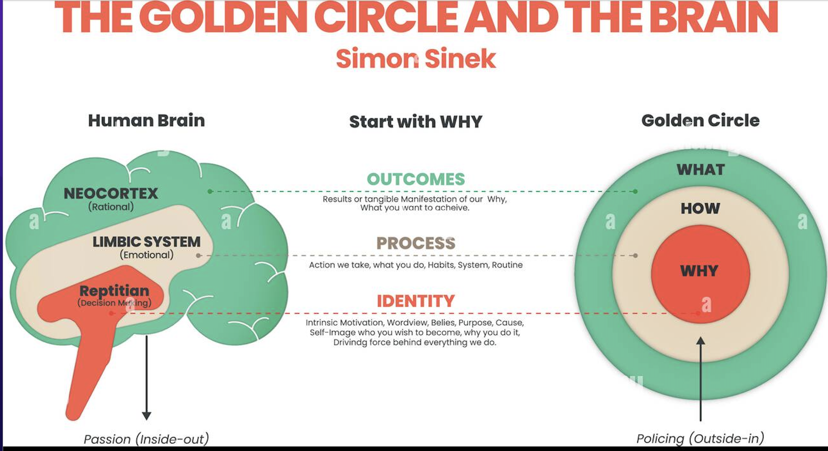
Golden Circle: Why, How, What

Slide 6
Challenge
To Be the BEST We Can Be.
  For us, our students.....and ultimately our patients.

Slide 7

Right People on the Bus!
Dean Shekhar isn't the driver.....
We are.
He is waiting for results back at the station

Slide 8
Challenge
To Be the BEST We Can Be.
  For us, our students.....and ultimately our patients.
Celebration: We have the right people on the bus

Slide 9

Train The Trainers
See ONE:
What is Co-Creation of the LE? Evidence?
How do we know if our LE is optimal for learning and caring?
Do ONE:
Skills in improving your Learning Environment
Teach ONE:
Go out and train your faculty
Institutional Support:
UPMC, UPSOM
Communication, Collaboration

Slide 10

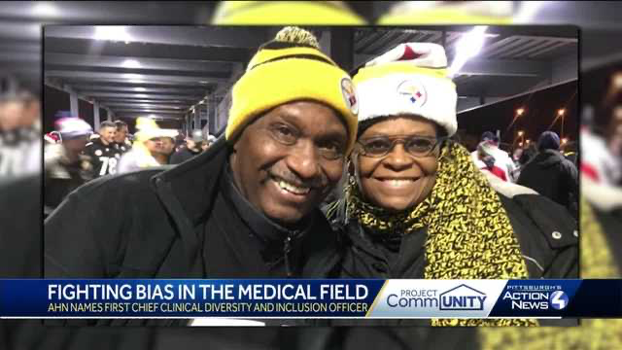
The Ultimate Outcome= Saving Lives One by One
Damar Hamlin: Dr. Peter Safar, the Father of CPR
But before Damar, there was Dr. P from the Hill District
1967
Morton Coleman, Philip Hallen, Dr. Safar
2015
Dr. Margaret Larkins-Pettigrew

Slide 11

Challenge
To Be the BEST We Can Be.
For us, our students.....and ultimately our patients.
Celebration:
Party Time: let's make it happen
IN A PLACE THAT HAS ALWAYS DONE THIS
Healers
Advocates
Innovators
Leaders
We have all the right people on the bus

Slide 12
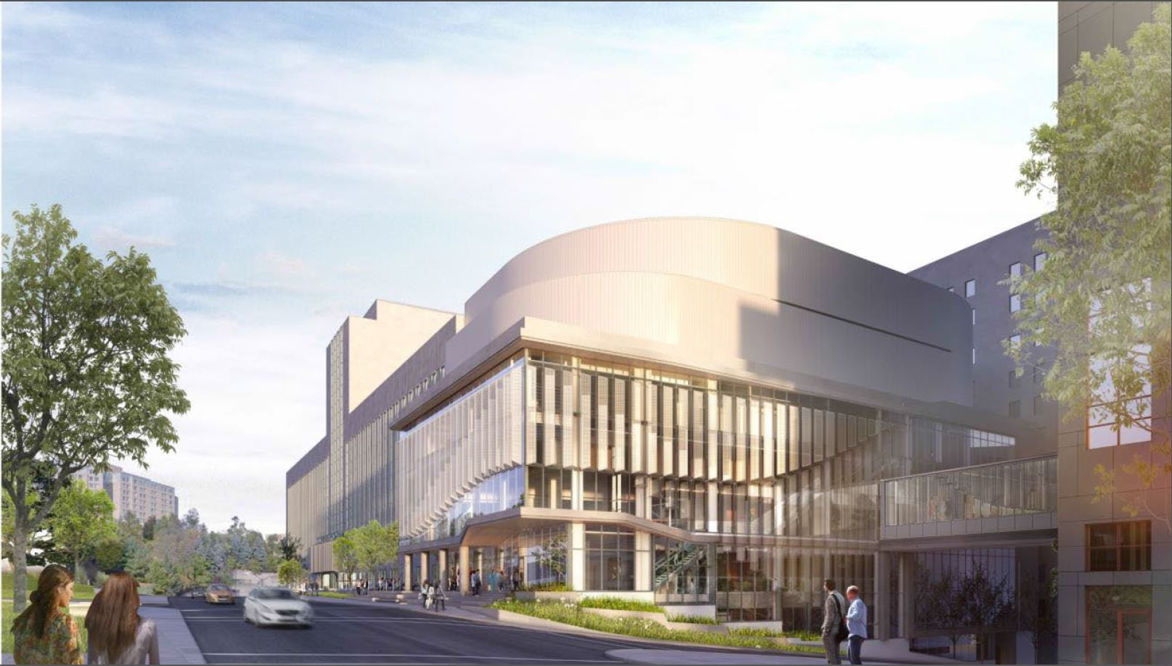
West Wing Update

Slide 13
Where are we at?
AV installation continues
Furniture installation begins February 22, 2023
Substantial completion: March 27, 2023
Equipment and other supplies to be moved through April
Current anticipated occupancy date: April 2023

Slide 14
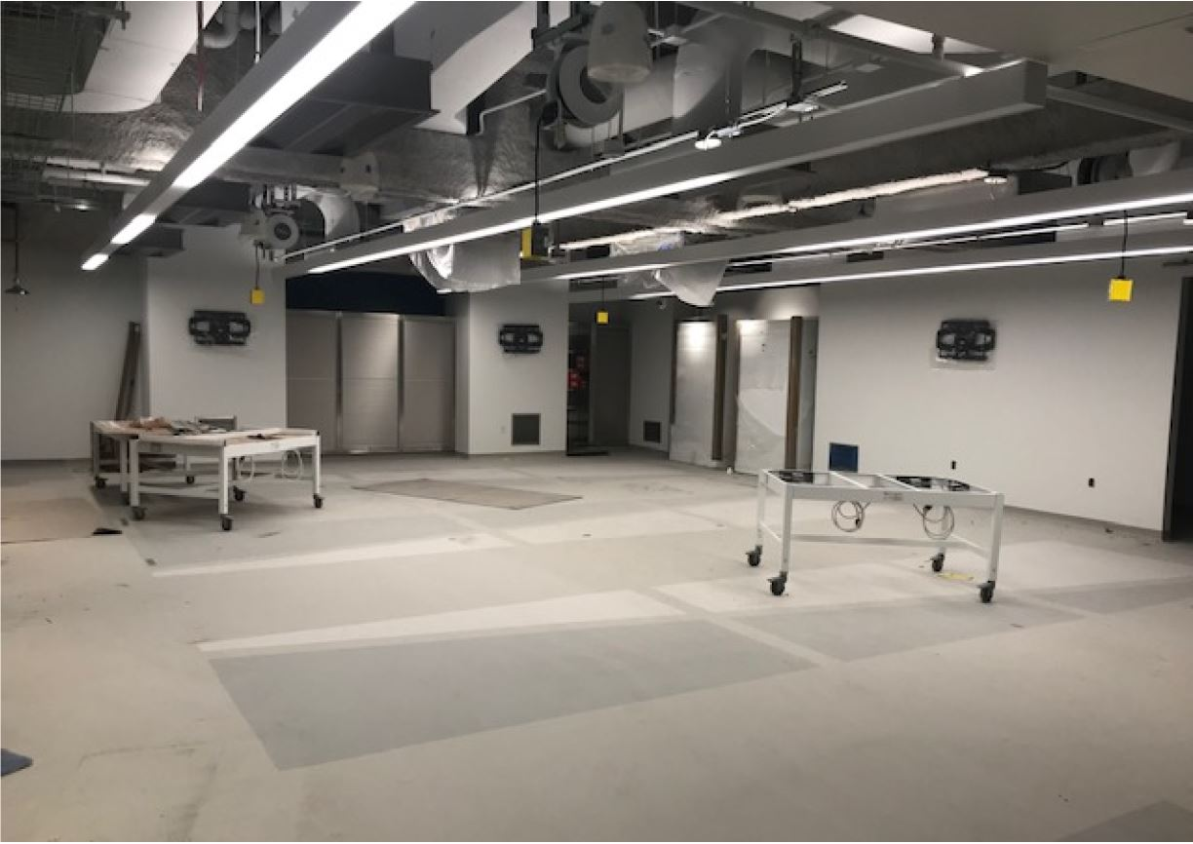
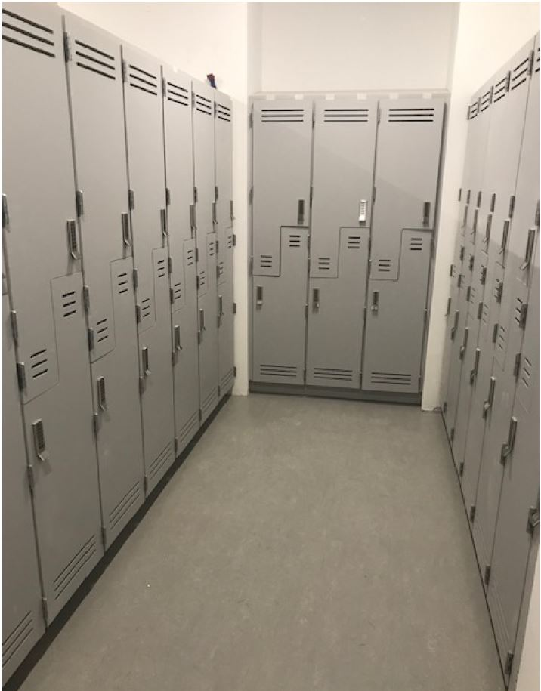
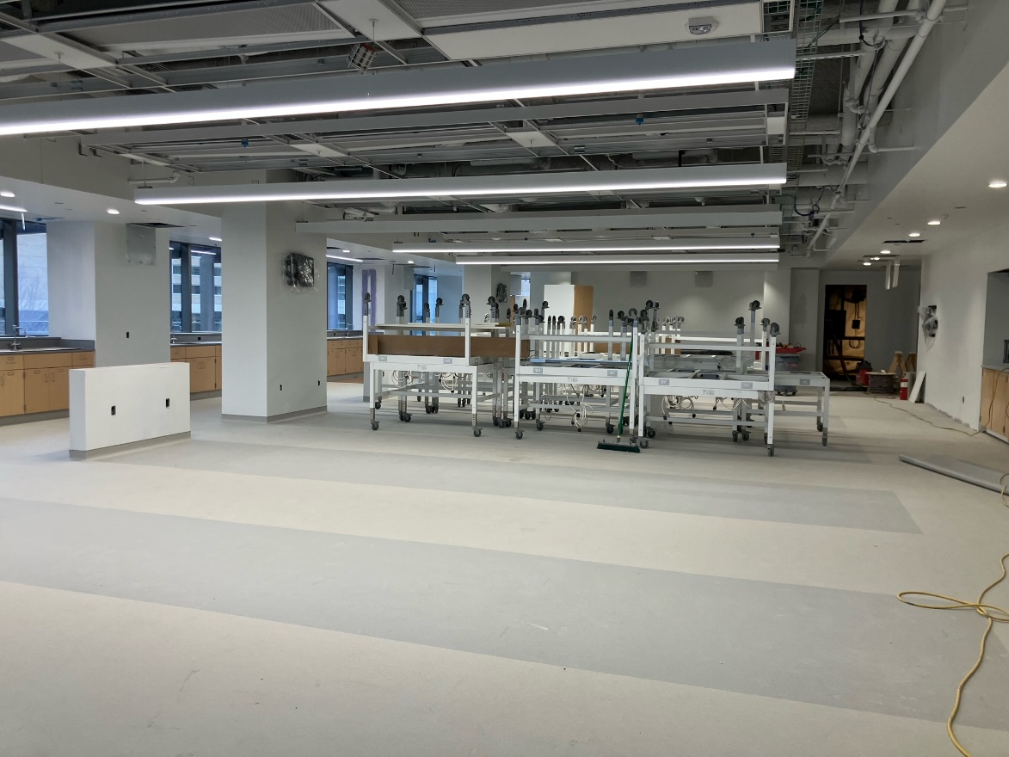

Slide 15
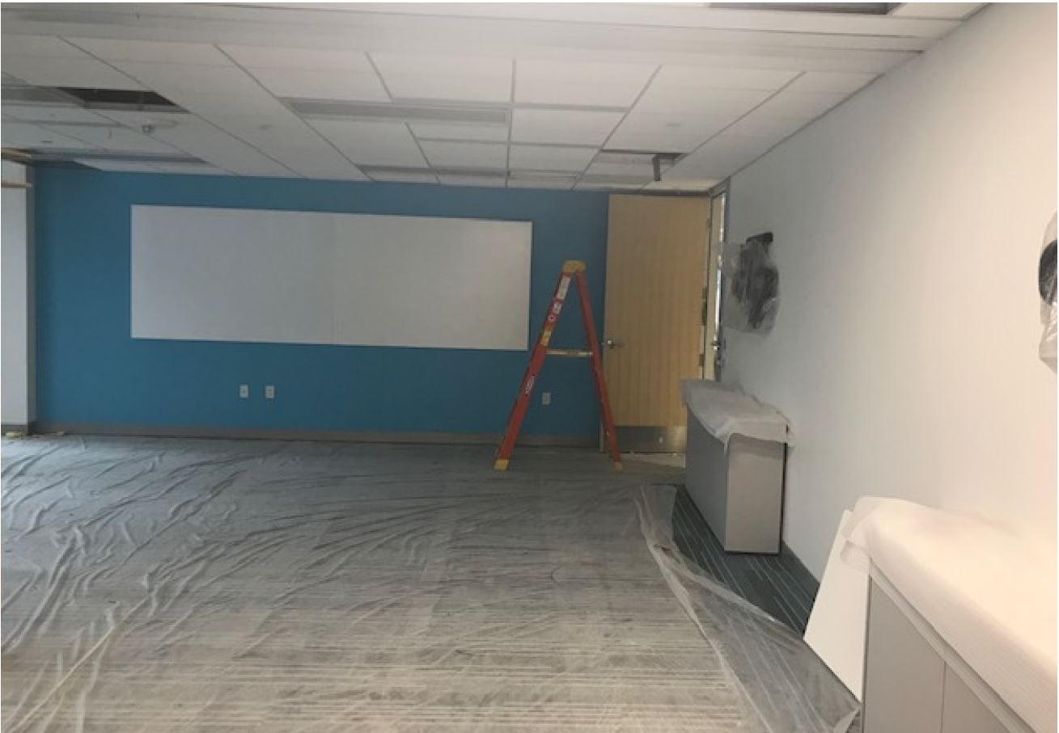
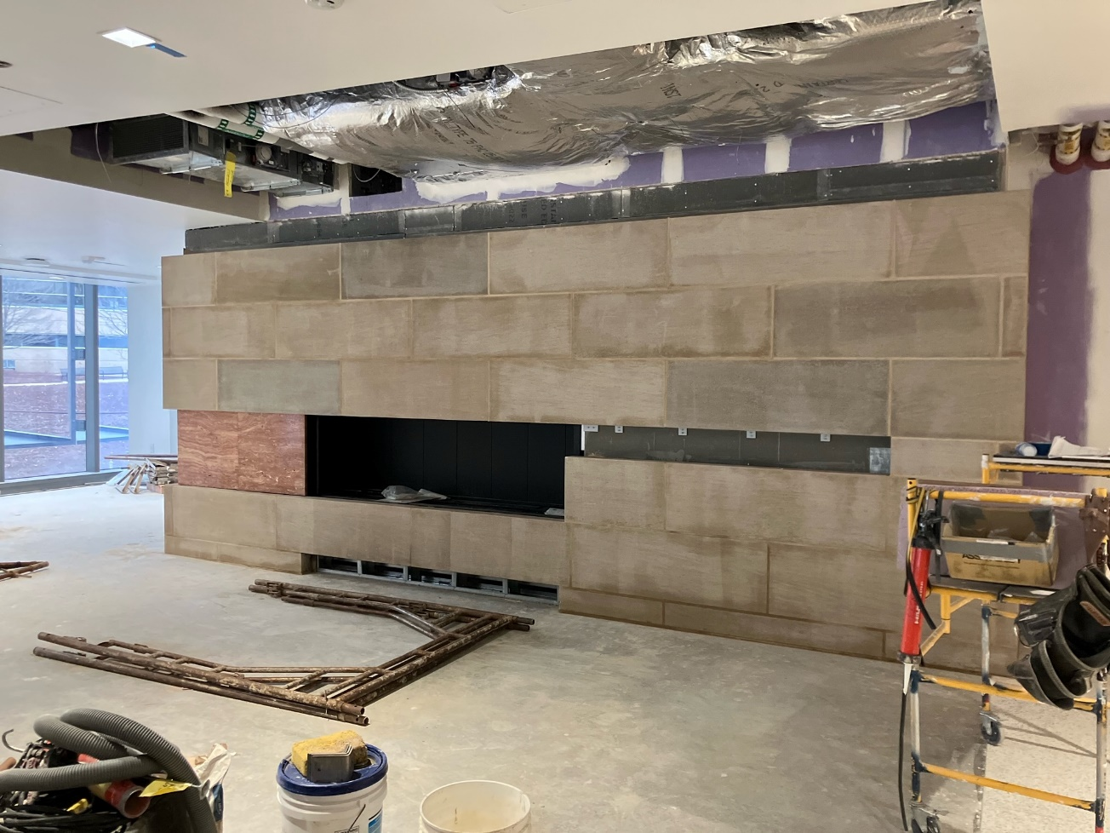
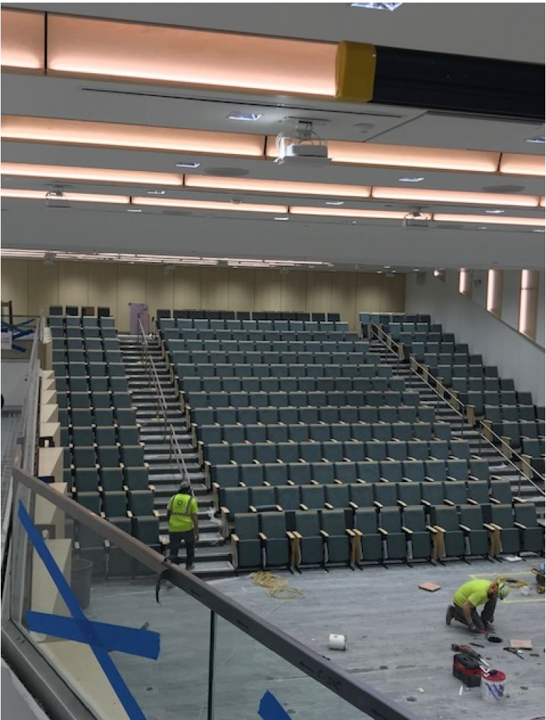

Slide 16
Space Constraints
Space Available during AY23-24​
  One 160 seat TBL room ​
  Two 80 seat TBL rooms (can open up to seat 160)​
  Two 40 seat TBL rooms (can open up to seat 80)​
  One 42 seat classroom​
  18 small group rooms (16 on current 5th floor, 2 in West Wing)​
  One 80 seat wet lab​
  One 160 seat gross anatomy lab​
What does this mean?​
  Not enough small group rooms for MS1 and MS2 to have workshops at the same time​
  Wet lab cannot seat a full class at one time​
  More opportunities for mid-size active learning groups

Slide 17
Renovation
Begins Summer 2023
Includes floors 2, M, 3, and 4
  Renovated library space
  Standardized Patient and simulation suite
  Upgraded teaching space
Projected to be complete Spring/Summer 2024

Slide 18
What’s Next?
Will move to new scheduling system
OMED is collecting 3RC weekly content to start reserving space
Get your course and event schedules to us as early as possible!
  Not sure what type of space you want to use? Reach out to us:
    Katie Maietta – krm58@pitt.edu
    Michelle Sergent – mls124@pitt.edu

Slide 19

Curriculum Reform Update

Slide 20
Strengthening the Learning Environment through Co-Creation
Raquel Buranosky, MD, MPH
Associate Dean for
Clinical Education
Pritha Workman, MD
Clerkship Director
Obstetrics & Gynecology
Evelyn Reis, MD
Associate Dean for
the Learning Environment
Lauren Burnette Stumpp
MS2 Curriculum Committee Representative

Slide 21
Agenda
Co-Creating the Learning Environment [The What]
Current state of the LE
Conceptual framework:
  Design by Participation
  Daily & Dynamic Partnership
The Daily and Dynamic:
Skills Workshop to Co-Create the Learning Environment [The How]

Slide 22
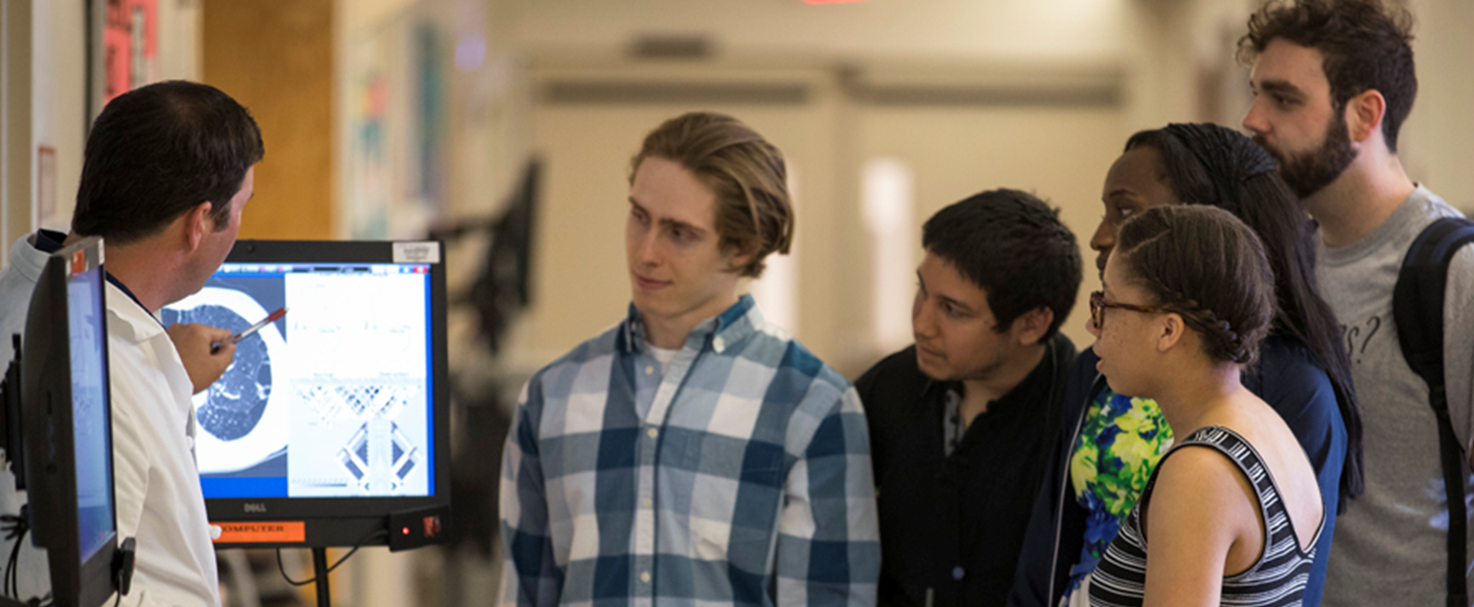
Learning Environment
Comprised of all of the individuals, experiences, and settings that shape our educational culture
Impacts and is impacted by educators, learners, staff, and patients

Slide 23
Current state of the LE
2022 AAMC Graduation Questionnaire (GQ)
  “Overall, I am satisfied with the quality of my medical education.”
    92.4% agree (50-75th percentile)
  “Emotional Climate”: how the educational experience supports students’ sense of achievement, confidence
    9.5 (0-15 scale) (50th percentile)
  “Student-Faculty Interaction”: students’ perception of faculty supportiveness
    14.0 (0-20 scale) (~50th percentile)

Slide 24
OMED student eval of educators
Preclinical instructors (2022 CoursEval)
  Instructor “consistently demonstrated professional behavior”
    4.9 (1-5 scale)
  “Instructors treated me and others with respect”
    4.8 (1-5 scale)
Clinical preceptors (2022 MedHub)
  Preceptor “consistently demonstrated professional behavior”
    92.7% To a very high degree
  Preceptor “created/supported a respectful learning environment”
    89.7% To a very high degree

Slide 25
“Hidden Curriculum”
2022 AAMC Graduation Questionnaire (GQ)
    “There are disconnects between what I am taught about professional behaviors/attitudes and what I see being demonstrated by faculty.”
      “Never” or ”almost never”: 43.5% (25-50th percentile)
  If you see unprofessional behavior
    Upstander skills!

Slide 26
2022 OLE incident report summary
Civil Rights/Title IX incidents
Racist/Ethnic
Gender/Sexist
Sexual orientation incidents
Other Mistreatment incidents
Verbal
Other incidents
Research
Physical
Educator Skills/Course concerns Unprofessional behaviors
Teaching skills issues Grade/Curriculum concerns
*Bars do not total to 100% because reports may have more than 1 incident type.
*Reports related to faculty, fellows, and residents

Slide 27
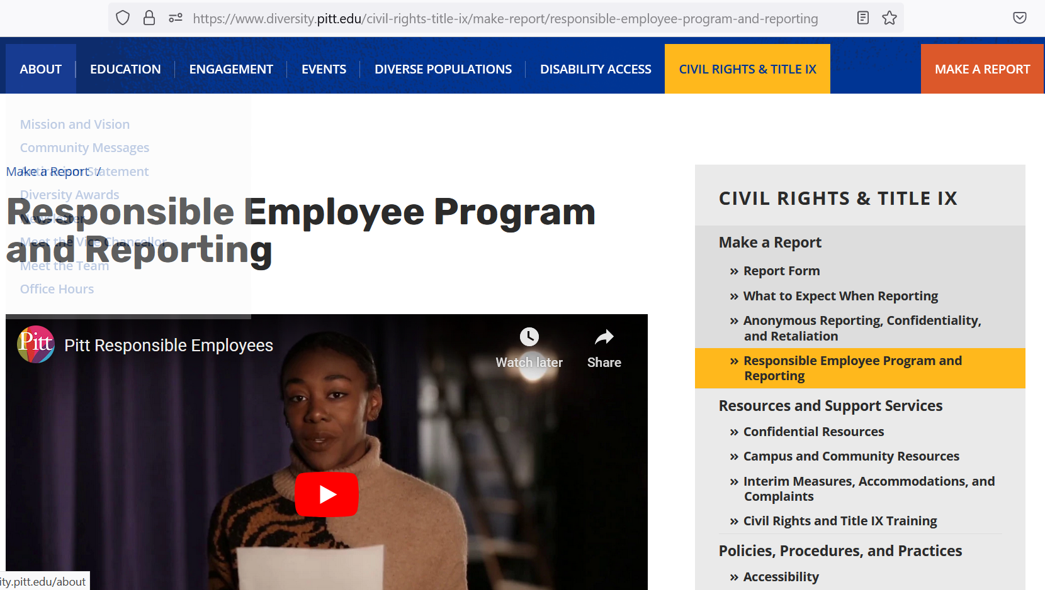
Title IX reminder
All University employees are responsible (mandated) to report sexual misconduct that they witness or hear about that affects Pitt students, staff, and faculty
Responsible Employee Program and Reporting | Office for Equity, Diversity, and Inclusion | University of Pittsburgh

Slide 28
2022 OLE incident report summary
Civil Rights/Title IX incidents
Racist/Ethnic
Gender/Sexist
Sexual orientation incidents
Other Mistreatment incidents
Verbal
Other incidents
Research
Physical
Educator Skills/Course concerns Unprofessional behaviors
Teaching skills issues Grade/Curriculum concerns
*Bars do not total to 100% because reports may have more than 1 incident type.
*Reports related to faculty, fellows, and residents

Slide 29

Educator Skills/Course concerns
Examples
  Rude, disrespectful, or other unprofessional behavior
  Teaching skillset not utilized (e.g., setting expectations, providing feedback)
  Unavailable or uninterested in teaching
  Ignored or did not include student in clinical care
  Unsupportive of students
  Evaluation/grade concern
  Curriculum concern

Slide 30
Student quotes
“Referred to a patient…as
‘straight up stupid’…”
“Said ‘make yourself helpful, don’t just
stand there’ in a condescending tone
on my first day…”
“Resident told me to
‘sit in a corner’
and pointed aggressively…”
“Said…I was ‘too cool and needed to fake more excitement’… I felt he was simply grading me on my personality.”
“She was very hands off and did not speak much to me at all...”
“My preceptor did not even take the time to learn my name...”

Slide 31
What is “Co-Creation”?
Definition:
“Close collaboration between learners and teachers, aiming to improve teaching and learning”
Participatory Design:
Improving the Quality of the Educational Experience
Daily, Dynamic Teacher-Learner Partnership:
TLC→ TLP
Partnering in the moment to create the most effective teaching and learning (and Patient-Centered) learning environment.
Involving students and teachers inclusively

Slide 32
Why do We Care?
Impact of Co-Creation by Cluster

Slide 33
Why do We Care?
Impact of Co-Creation
Psychosocial Learning Environment
Motivation and Metacognition
Quality of Educational Design

Slide 34

Co-Creation ----→
Psychosocial Learning Environment
Enhanced
  Relationships
  Sense of Identity
  Sense of Belonging
  Sense of Cohesion
SKILLS:
  Communication
  Collaboration
  Conflict Management and Civility
  Implicit Bias Training
  Upstander Training

Slide 35

Co-Creation ---→
Motivation and Metacognition
Enhanced
  Perspectives of teachers’ ←--→ learners’ on education
  Ownership, Responsibility, Engagement, Motivation, Confidence
SKILLS (metacognitive):
  Ability to use prior knowledge to
  plan a strategy for approaching task,
  take steps to problem solve,
  reflect on and evaluate results,
  modify one's approach as needed

Slide 36

Co-Creation---→
Quality of Educational Design
Enhanced
  Expertise of All Stakeholders
SKILLS
  ”Seriously listening” to each others’ voices increased:
    Learner performance
    Perceptions
    Attendance
  Design and Outcomes Analysis and REFLECTION
  PDSA Cycles (self and system)

Slide 37
Who Contributes to the Co-Creation of LE?
PUTTING IT ALL TOGETHER!

Slide 38
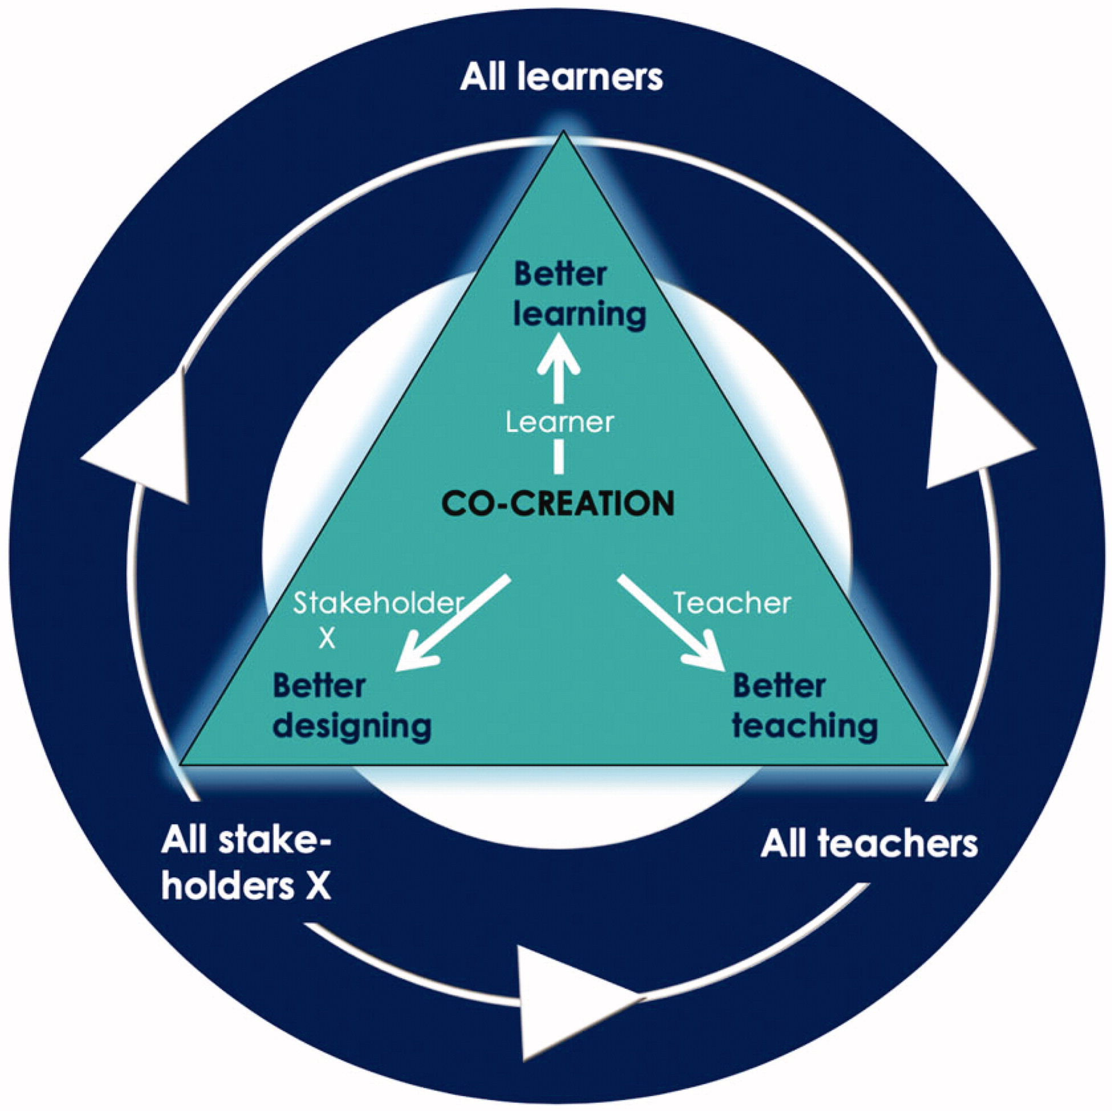
Framework of
Stakeholder Involvement
in
Co-Creation
Design Plan:
Outer to Inner
Curricular Reform
Student Advisory Groups
ELEAP
Affinity Group Leads
Curricular Reps
Class Leaders
JoLT
Daily Doing:
Inner to Outer Circle:
Intentionally Skillful
Role Modeling
Train the Trainers

Slide 39
Co-Creation Skill Development: The How by Role
For Teachers
For Learners
For Teachers and Learners
For Organization

Slide 40
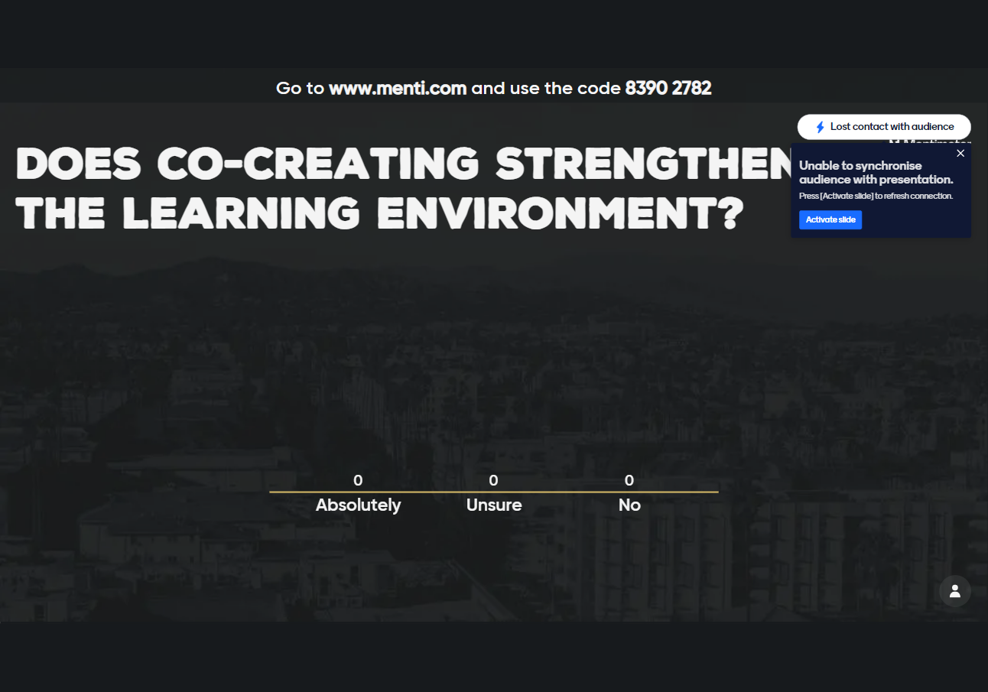

Slide 41


Slide 42
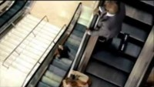

Slide 43



Slide 44
Co-Creation of LE Challenges
Learner Level:
  Lack of process and content expertise
  Power Relationships
  Voice Fatigue and Feeling Unheard
Teacher Level
  Giving up Control
  Skepticisms that Learners Add Value
  Perceived threats in opening up for change
  Usual way of Communication no longer fits
Institutional Level
  Lack of Support
  Lack of Recognition

Slide 45
How to become "unstuck" when confronted by systems limitations

Slide 46
Demonstration:
Identify “what went well?”
Role play:
  Pre-clinical problem based learning group
Your task? Identify how the group “got unstuck?”

Slide 47
Student quotes
“I feel like I understood the material so much better now”
“I can’t wait for our next workshop”
“She kept using my name…which made me feel like I was contributing meaningfully”
“I cannot wait to go through the material and review it again”
“The way she relied on our experiences was so refreshing”
“This was great!”

Slide 48
What went well?
Impact of Co-Creation: Bi-directional
Psychosocial Learning Environment
Motivation and Metacognition
Quality of Educational Design

Slide 49
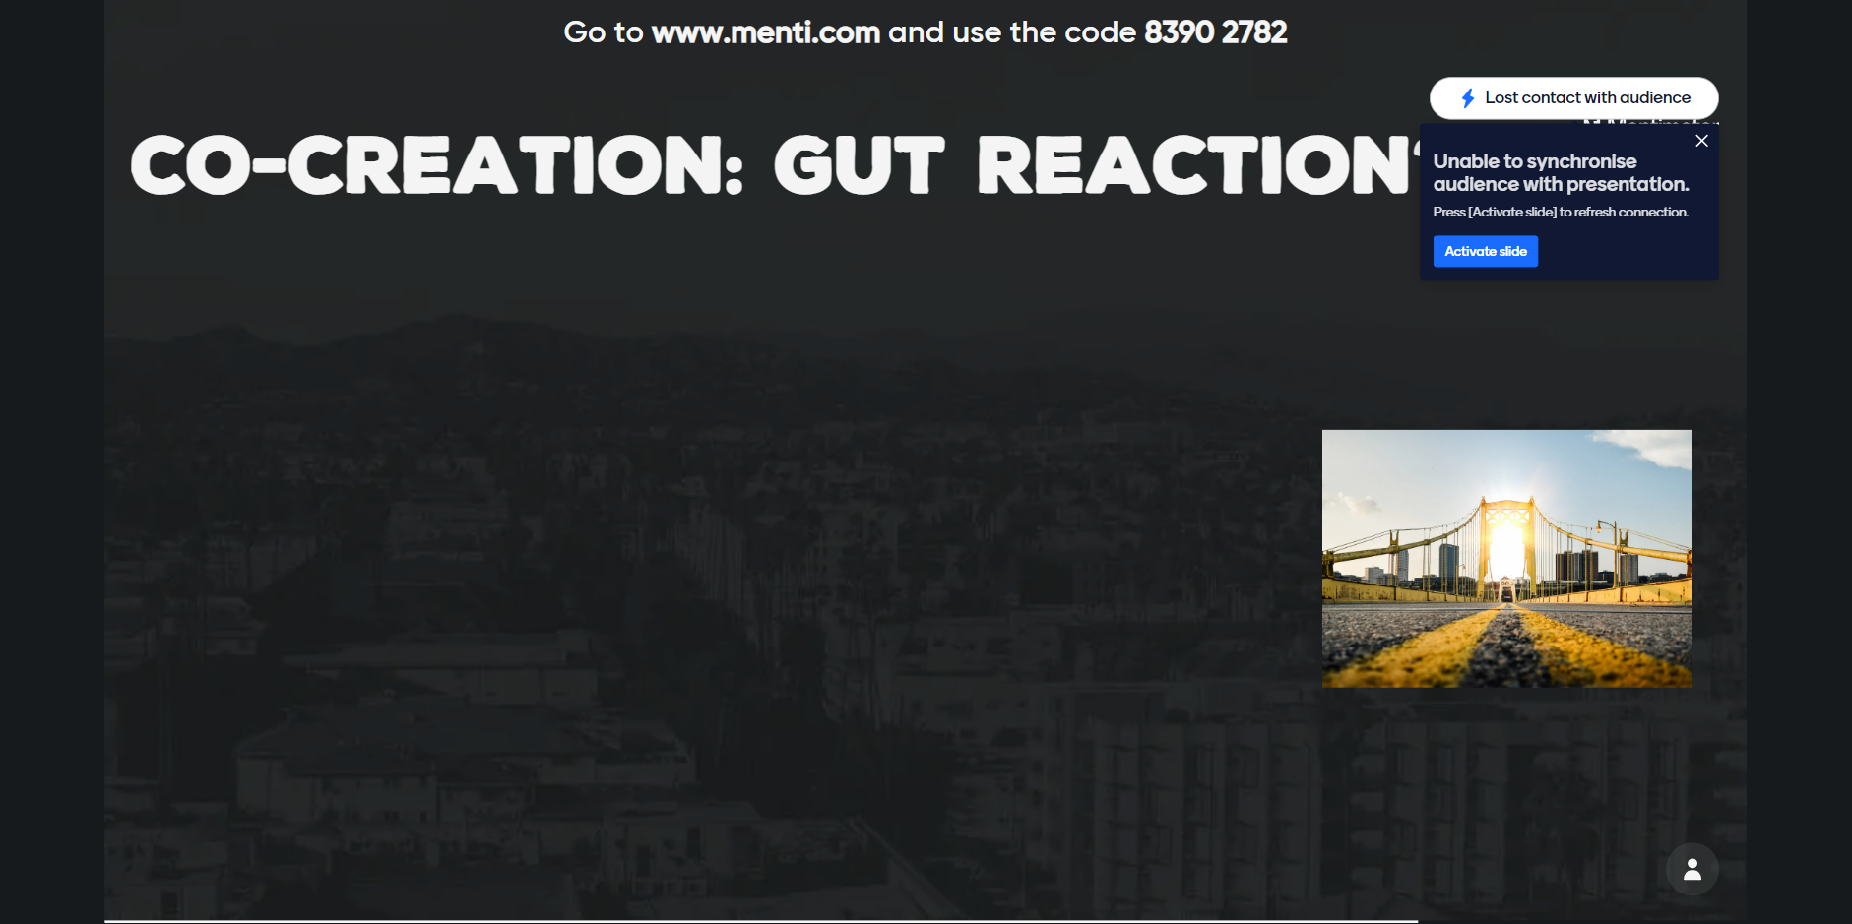

Slide 50
Co-Creation LE Wrap Up
What is one thing you do well?
What is one thing you want to do differently?

Slide 51
Next Steps
Reflection and Action….and Planning…and Doing…
And Reflection and Action…..

Slide 52
Break
Mindfulness Activity

Slide 53
Becoming an UPSTANDER:
Action tools to Create a Safe, Empowering Environment
Rickquel Tripp, MD, MPH
Vice-Chair for Diversity, Equity and Inclusion
UPMC Medical Education
Emilia Diego, MD
Vice-Chair for Diversity, Equity and Inclusion, Department of Surgery

Slide 54
Ground Rules to Create a Safe Environment
Actively Participate & Stay Engaged: Share your story & state your opinion. Use “I” statements. All questions are valid— risk and grow in bravery!
Speak Your Truth: Value everyone’s thoughts & initially assume good intentions. It’s important that everyone is free to speak openly & disagree respectfully
Be Honest, Authentic, Open-minded, Present, & Vulnerable
Allow for mistakes/Faux pas: There will be concerns of saying something wrong. Consider these learning opportunities.
Actively Listen for Understanding: Listen and try to understand where another person is coming from as best as you can.
Suspend Judgement & Critique
Honor & Respect Confidentiality: What is shared here, stays here. [Vegas Rules]
Expect and Accept Non-closure/ No resolution: Race conversations are challenging and ongoing. Accept that much of this is about changing yourself, not others.
Responsibility to Each Other and to the Process: Everyone should follow the ground rules and propose news ones to create a safe environment for sharing
UN Human Rights Commission: https://www.standup4humanrights.org/en/fightracismengage.html

Slide 55
Distress Warning
During this presentation, examples of instances of bias and microaggressions are described, which may cause an emotional reaction depending on our lived experiences.
It is important we regulate our own trauma and emotions of anger, hurt, & disappointment when encountering these situations and help others learn from our experiences.

Slide 56



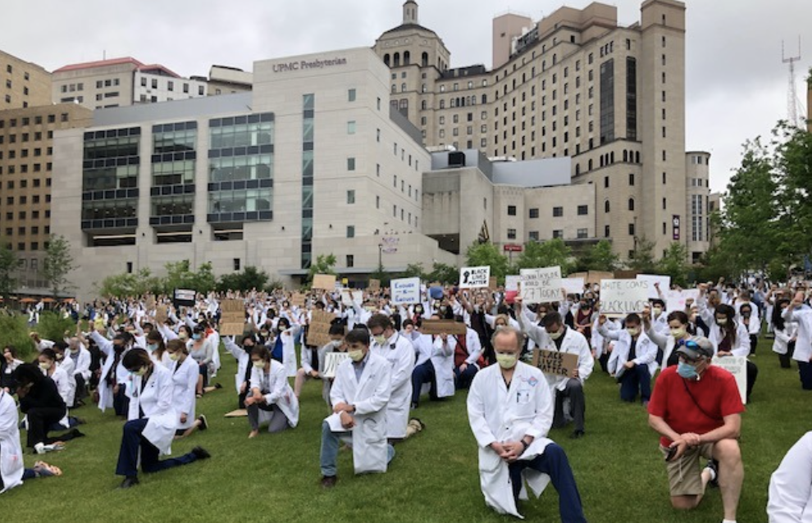

We are ALL accountable

Slide 57
Real World Implications
Real world effects upon judgement, verbal and non-verbal behavior towards others, and health disparities
Racial and ethnic minorities and women are subject to less accurate diagnoses, curtailed treatment options, less pain management, and worse clinical outcomes
Black children are often not treated as children at all, or not given the same compassion or level of care provided to white children
Chapman, Katz, & Carnes, 2013
Johnson et al., 2017

Slide 58

How Does Implicit Bias Affect Healthcare?
Notes:
https://www.youtube.com/watch?v=ze7Fff2YKfM

Slide 59
Bystander Effect
Psychosocial theory: individuals are less likely to offer help to a victim when there are other people present
  Assume someone else will respond (to justify personal non-response)
  Passive, only watches
  Present without action

Slide 60
Bystander Toolkit: Become an UPSTANDER
Why? Ubuntu philosophy.
  “I am because we are.”
  “Humanity towards others.”
Intervene in the interest of helping someone and acting in a TIMELY manner
  Daily acts of harm: bias, harassment, bullying, inappropriate behavior with racist or sexist comments
  Periodic high-risk situations: physical or sexual assault, acts that threaten safety
https://www.africaw.com/african-philosophy-ubuntu-a-way-of-life. Accessed 28 Feb 2021.

Slide 61
Bystander Toolkit: Become an UPSTANDER
Be a CHANGE MAKER
Be an ADVOCATE
Be a HERO for someone who has experienced an injustice
ANYONE CAN BE AN UPSTANDER

Slide 62
IQEE: Speak UP against Injustice
Interrupt
Excuse me, can I just clarify what I heard?
Before we continue, I want to talk about the language you just used.
Echo
Thank you for saying something.
I agree with that, and let me add…
Interrupt
Excuse me, can I just clarify what I heard?
Before we continue, I want to talk about the language you just used.
Question
Why do you feel that way?
Why do you think some people may find what you said harmful or inappropriate?
Educate
I’d like to share a different perspective.
Let me share my personal experiences.
Echo
Thank you for saying something.
I agree with that, and let me add…
Question
Why do you feel that way?
Why do you think some people may find what you said harmful or inappropriate?
Educate
I’d like to share a different perspective.
Let me share my personal experiences.
Adapted with permission of Learning for Justice, a project of the Southern Poverty Law Center. www.tolerance.org

Slide 63
IQEE: Speak UP against Injustice
Interrupt
Excuse me, can I just clarify what I heard?
Before we continue, I want to talk about the language you just used.
Interrupt
Excuse me, can I just clarify what I heard?
Before we continue, I want to talk about the language you just used.
Speak Up & Use your Voice
Silence signals acceptance or complacency
Be non-threatening & non-judgmental
Check tone
Clarify the “What” or meaning behind the statement
Adapted with permission of Learning for Justice a project of the Southern Poverty Law Center. www.tolerance.org

Slide 64
IQEE: Speak UP against Injustice
Question
Why do you feel that way?
Why do you think some people may find what you said harmful or inappropriate?
Question
Leverage curiosity in a non-threatening manner (TONE matters)
Attempt to understand offender’s perspective
Use opportunity to ask offender to reflect and explain (the WHY)
Why do you feel that way?
Why do you think some people may find what you said harmful or inappropriate?
Adapted with permission of Learning for Justice, a project of the Southern Poverty Law Center. www.tolerance.org

Slide 65
IQEE: Speak UP against Injustice
Educate
I’d like to share a different perspective.
Let me share my personal experiences.
Educate
Reframe: consider impact on individual receiving comment
Teach by using empathic ”I” statements and personal experience
Paraphrase to make what was invisible (unconscious bias) now visible
I’d like to share a different perspective.
Let me share my personal experiences.
Adapted with permission of Learning for Justice, a project of the Southern Poverty Law Center. www.tolerance.org
Adapted from WELL Toolkit “Microaggressions” by Dr. Eloho Ufomata, Dr. Alda Gonzaga, Dr. Eliana Bonifacino

Slide 66
IQEE: Speak UP against Injustice
Echo
Thank you for saying something.
I agree with that, and let me add…
Echo
Reinforce the Upstander atmosphere
Empower each other to help break down bias & amplify voices
Prompts 2-part approach:
  Acknowledge & Apologize
  Resistance & Re-educate or Report
Make sure to address later if unable to in the moment
Thank you for saying something.
I agree with that, and let me add…
Adapted with permission of Learning for Justice, a project of the Southern Poverty Law Center. www.tolerance.org

Slide 67
Let’s Practice:
Responding to Microaggressions and Bias

Slide 68
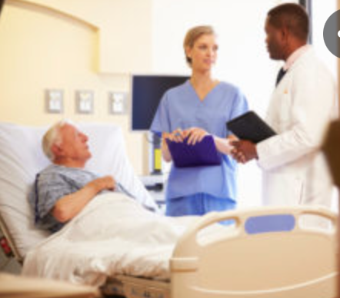
Case: Patient towards Trainee
You are on the inpatient floor. Stephen Brown (a Black medical student) has just started his rotation. While rounding on the patient Ms. Taylor as a group, the patient specifically looks at Stephen and demands for him to get her a blanket and a cup of water while the real doctors talk to her.

Slide 69
When Addressing Patients
Approach the patient/speaker in the moment
Redirect the conversation to focus on the patient’s medical care 1st then end with “teaching” moment
  “I’m very concerned about your medical issues, so let’s focus on how we can help you today…. I would like to come back to what you said about my resident/student/ myself...”
Focus on building rapport and assessing patient’s concerns
  Discrimination may be motivated by patient’s fears & anxiety about the unknown & lack of control or by previous visits where they experienced injustice
Whitgob E. Acad Med 2016; 91(11):S64-S69.
Adapted from WELL Toolkit “Microaggressions” by Dr. Eloho Ufomata, Dr. Alda Gonzaga, Dr. Eliana Bonifacino

Slide 70
When Addressing Patients
Cultivate a therapeutic alliance
Depersonalize the event by expressing nonjudgmental curiosity
  “What makes you think I’m/she/he is not a real doctor?”
Refer to residents as “Dr.” and medical students as “student Dr.” in front of patients
  Establish validity, credibility, and purpose for the patient
Whitgob E. Acad Med 2016; 91(11):S64-S69.
Adapted from WELL Toolkit “Microaggressions” by Dr. Eloho Ufomata, Dr. Alda Gonzaga, Dr. Eliana Bonifacino

Slide 72
IQEE: Speak UP against Injustice
Interrupt
Excuse me, can I just clarify what I heard?
Before we continue, I want to talk about the language you just used.
Interrupt
Excuse me, can I just clarify what I heard?
Before we continue, I want to talk about the language you just used.
Ask the speaker to elaborate what they mean (the WHAT) & check tone
Clarifies the meaning behind their statements
“I’m curious, Ms. Taylor, what role do you think student Dr. Brown has in your care?”
“Excuse me, Ms. Taylor, what makes you believe that student Dr. Brown should not be present while we round on you since we can all bring you a blanket and water afterwards?”
Adapted with permission of Learning for Justice, a project of the Southern Poverty Law Center. www.tolerance.org

Slide 73
IQEE: Speak UP against Injustice
Question
Why do you feel that way?
Why do you think some people may find what you said harmful or inappropriate?
Interrupt
Excuse me, can I just clarify what I heard?
Before we continue, I want to talk about the language you just used.
Interrupt
Excuse me, can I just clarify what I heard?
Before we continue, I want to talk about the language you just used.
Demonstrates attempt at understanding their perspective (the WHY)
Be open to ALL responses to reduce defensiveness
“Ms. Taylor, why do you think student Dr. Brown is not essential to your care team and does not need to be present while we are discussing your concerns and management?
Adapted with permission of Learning for Justice, a project of the Southern Poverty Law Center. www.tolerance.org

Slide 74
IQEE: Speak UP against Injustice
Question
Why do you feel that way?
Why do you think some people may find what you said harmful or inappropriate?
Educate
I’d like to share a different perspective.
Let me share my personal experiences.
Interrupt
Excuse me, can I just clarify what I heard?
Before we continue, I want to talk about the language you just used.
Interrupt
Excuse me, can I just clarify what I heard?
Before we continue, I want to talk about the language you just used.
Create a different way of looking at the situation
Use empathic “I” to communicate impact while avoiding blame
Help speaker uncover their own unconscious biases
“I felt disheartened when you were dismissive of student Dr. Brown and not realizing he is an essential member to this team and your care.”
Adapted with permission of Learning for Justice, a project of the Southern Poverty Law Center. www.tolerance.org

Slide 75
IQEE: Speak UP against Injustice
Echo
Thank you for saying something.
I agree with that, and let me add…
Interrupt
Excuse me, can I just clarify what I heard?
Before we continue, I want to talk about the language you just used.
Interrupt
Excuse me, can I just clarify what I heard?
Before we continue, I want to talk about the language you just used.
2 part approach from both parties:
  Apologize & acknowledge VS Resistance & Re-educate or Report
Ms. Taylor: “I’m sorry and didn’t meant to offend student Dr. Brown. I just needed a blanket and a cup of water, but didn’t realize that I inappropriately tasked student Dr. Brown without realizing his importance in my care. Thank you."
Ms. Taylor: ”I think you are being too sensitive, I just asked.”
You: “Ms. Taylor, from your demanding tone, I did not feel you were asking. I would like to discuss more about us building a better understanding of student Dr. Brown’s important role in your care.”
Adapted with permission of Learning for Justice, a project of the Southern Poverty Law Center. www.tolerance.org

Slide 76
Strategies After an Event
It is the responsibility of the attending/ any senior leadership position to establish a safe, just learning and work environment for staff, nurses, students, residents, and fellows
Stand UP for student/trainee/mentee in the moment 1st, then check-in with victim afterwards about emotions
Avoid involving the victim in conversation with the offender to avoid re-traumatizing
Whitgob E. Acad Med 2016; 91(11):S64-S69.
Adapted from WELL Toolkit “Microaggressions” by Dr. Eloho Ufomata, Dr. Alda Gonzaga, Dr. Eliana Bonifacino

Slide 77
Strategies After an Event
Response type should be proportional to the likely length of exposure and the gravity/level of the microaggression/bias
  Short time=> more direct, firm
  Multiple visits=> repeated education and reinforcement
  Gravity=> more severe, stronger message
Goal:
  Engage the offender to address his/her/their implicit bias
  Uplift & support the victim as an ally/ UPSTANDER
  Empower those around to speak up
Whitgob E. Acad Med 2016; 91(11):S64-S69.
Adapted from WELL Toolkit “Microaggressions” by Dr. Eloho Ufomata, Dr. Alda Gonzaga, Dr. Eliana Bonifacino

Slide 78
Strategies After an Event
Debrief with team and victim in a timely manner
  Articulate what behaviors are not tolerated by the hospital and institution
  State the importance of workplace safety, RESPECT, and well-being
  Emphasize and promote your targeted colleague’s competence, value, and abilities
Personal Reflection
  Identify own biases, triggers, and personal boundaries
  Reflect on your own reaction to the event
Provide support, advocacy, & mentorship
Whitgob E. Acad Med 2016; 91(11):S64-S69.
Adapted from WELL Toolkit “Microaggressions” by Dr. Eloho Ufomata, Dr. Alda Gonzaga, Dr. Eliana Bonifacino

Slide 79
Approaches to Mitigating Implicit Bias
Common Identity Formation/ Build Commonality
Don’t stop the conversation until you find some common ground i.e. interests/ activities
Perspective taking
Empathy actively reduces unconscious bias.
Try picturing yourself in the other person’s shoes.
Consider the opposite
When you have information that leads you to one conclusion, force yourself to consider data supporting the opposite before making a final decision.
Counter Stereotypical Exemplars
Instead of focusing on biases against a particular group, look for qualities among people in that group that you admire.
Shared common identity between YOU & the person
Capers, QuiCnn. Implicit Bias Training. https://medicine.osu.edu/diversity/initiatives/implicit-bias-training

Slide 80
Receiving Feedback: How to respond when you are ”Called out”
I recognize that I have work to do.
I’m going to take some time to reflect on this.
I appreciate the effort & time that you’ve put into tell me.
I apologize, I’m going to do & be better.
How can I make this right & prevent from happening again?
What I’m gathering is (insert what you learned).
Thank you.
I believe you.
https://everydayfeminism.com/2017/05/allies-say-this-instead-defensive/

Slide 81
What are YOUR ACTION items?
Allow colleagues to share or define their own demographic groups rather than labeling someone based on your assumptions
Reach out to colleagues who are different from you to understand their experiences over lunch, coffee, etc
Read at least 3 articles/ books related to diversity (or a specific demographic group) in the workplace

Slide 82
What are YOUR ACTION items?
Attend an event where you will be in the demographic minority
Discuss career goals with a more junior colleague from a different background or demographic group than yourself
Actively sponsor & mentor individuals of diverse backgrounds and demographic groups
Be a Powerbroker

Slide 84
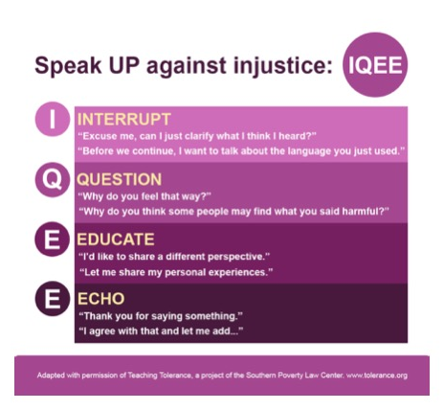
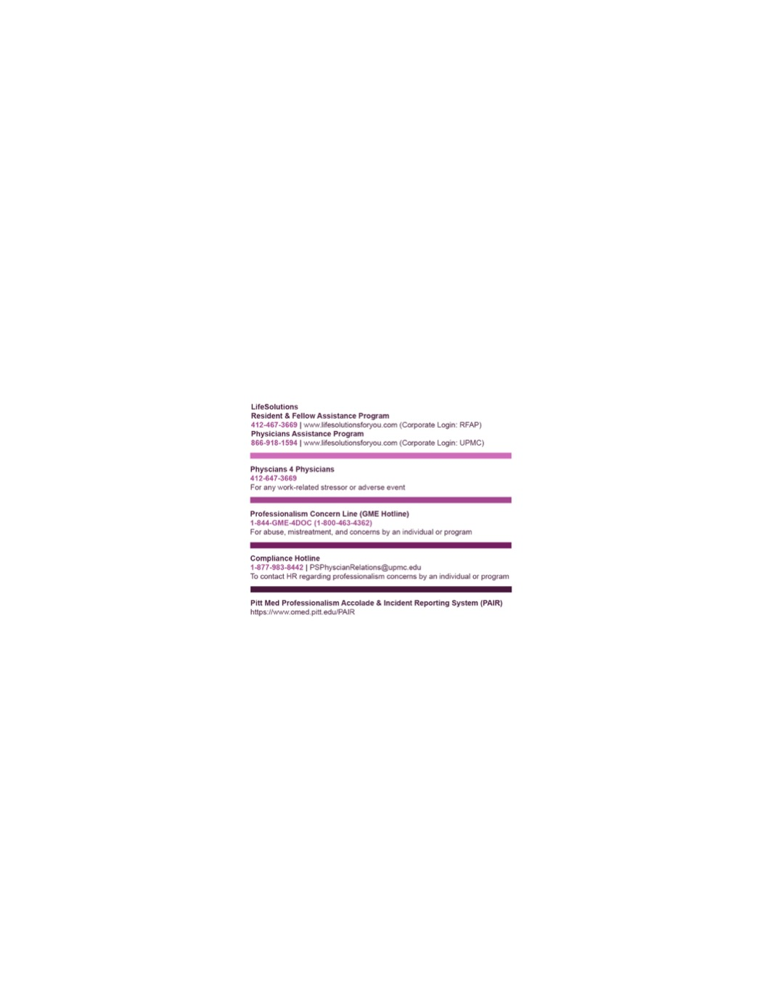
UPSTANDER Badge Buddy

Slide 85
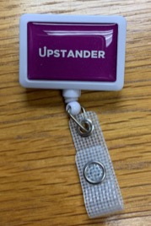
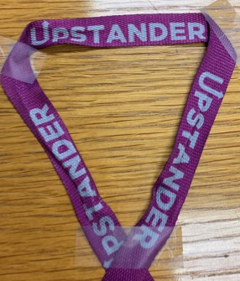
UPSTANDER Badge Reel Holder and Lanyard

Slide 86
PLEDGE TO FIGHT INJUSTICE
I will stay engaged and celebrate diversity, equity, & inclusion
I will be open & speak my truth, allowing others to do the same
I will acknowledge and apologize for any bias and/or microaggression I may commit
I will allow myself to experience discomfort to support my colleagues, push past it, confront it and use it to effect positive change
I promise not to be silent and ACT in the face of injustice or mistreatment to anyone
Acosta, David MD; Ackerman-Barger, Kupiri PhD, RN Breaking the Silence: Time to Talk About Race and Racism, Academic Medicine: March 2017 - Volume 92 - Issue 3 - p 285-288. Olayiwola JN. Racism in Medicine: Shifting the Power. Annals of Family Medicine. 2016 May;14(3):267-269..
Adapted from Well Toolkit

Slide 87
RESOURCES: Suggested Reading & Videos to Promote Awareness
What Does it Mean To Be White? Developing White Racial Literacy by Robin DiAngelo
White Fragility by Robin DiAngelo
How to be Anti-Racist by Ibram X. Kendi
Me and White Supremacy by Layla Saad
Whistling Vivaldi: And Other Clues to How Stereotypes Affect Us (Issues of Our Time) by Claude Steele
Allegories on Race and Racism by Dr. Camara Jones https://www.youtube.com/watch?v=GNhcY6fTyBM
Why are they angry with us by Larry Davis
Medical Apartheid by Harriet A. Washington

Slide 88
TAKE HOME POINTS
We all have implicit bias
Implicit & explicit biases can lead to microaggressions
Microaggressions are like mosquito bites or “hundreds of papercuts” which may seem small in nature, but very painful in impact
Need for everyone to become an Upstander -> changing our culture
Be supportive with mentorship and allyship to our colleagues in the face of microaggressions

Slide 89
Special Thanks
Ms. Jacqelyn Johnson for her creative skills in helping us design the badge buddy
Dr. Sara Myers for the idea of a badge buddy for Upstanders
Drs. Eloho Ufomata, Alda Gonzaga, and Eliana Bonifacino for giving us permission to adapt a few slides from their Microaggression presentation located in the WELL Toolkit https://gmewellness.upmc.com

Slide 90
NORMALIZE the culture of Standing UP
Takes time & practice
Become comfortable about the uncomfortable
Feel free to contact us with any questions/ comments: Dr. Tripp @ tripprp@upmc.edu Dr. Diego @ diegoe@upmc.edu

Slide 91
Promoting Professional Behavior and Civility
Greg Bump, Naudia Jonassaint, Joseph Losee, Jason Rosenstock
2/9/23
With material/guidance provided by Melinda Hamilton, Julie McCausland, and Franklyn Cladis

Slide 92
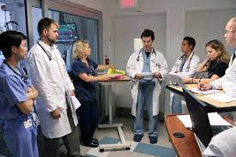
Goals
By the end of this session, participants will be able to:
Describe the concept of psychological safety and how that affects team performance in a learning environment
State interventions that could be used to improve civility in various work contexts
Commit to sharing these insights with others in your work groups

Slide 93
Scenario
Resident: Why are you taking so long?
MS-3: I am sorry. I am doing my best.
After 2 min, the resident gets upset
Resident: You are doing it all wrong!
MS-3: Oh, I am sorry. Can you please show me how to do it right?
Resident: Are you serious? You are a third-year medical student and you don't know how to close skin?
[laughing (nurses and OR tech start laughing too, student feels embarrassed)]
MS-3: I’m sorry! I didn’t get much surgical exposure prior to this rotation.
Resident: I think you should consider options other than doing surgery. Medicine might be better for you.
MS-3: But I really love surgery and I want to do my best to learn how to do it.
Resident: It's too late.
…the resident takes over the closure and does not let the medical student do anything
Cue scene - A resident and a medical student are in the OR closing skin at the end of the surgical case. The Attending gives the Medical student (MS-3) the opportunity to “close”.

Slide 94

Scenario: Discussion
Is this uncivil? Unprofessional? Mistreatment?
Is this important?
Why does this happen?

Slide 95

Civility and Psychologic Safety are Closely Related

Slide 96
UN-Professionalism in Medical Organizations
Unprofessional or uncivil behaviors impact patient safety
Incivility is a subset of unprofessional behaviors
Results of uncivil behaviors – Attrition, Burnout, Less Innovation etc.
Bullying
Verbal abuse or rudeness
Excessive competitiveness
Social exclusion
Inaction (e.g., not responding to e-mails), and other forms of disrespect

Slide 97
Uncivil Behaviors – Effects
EVENT TYPE # (%) of EVENTS
Error related to procedure/treatment/test 12 (27.3)
Complication of procedure/treatment/test 5 (11.4)
Medication error 1 (2.3)
Transfusion 1 (2.3)
Other/miscellaneous 25 (56.8)
CATEGORIES # (%) of EVENTS
Verbal abuse (e.g., rude behavior) 34 (77.3)
Intimidating behaviors (e.g., badgering) 32 (72.7)
Work interference (e.g., sabotage) 13 (29.5)
Humiliating behaviors (e.g., mimicking) 7 (15.9)
Threatening behaviors (e.g., frightening) 6 (13.6)
Note: As reported to the Pennsylvania Patient Safety Authority, July 1, 2014, through June 30, 2016.
Wallace S. PPSA 2017 Vol 14(2) Bullying in Healthcare: A Disruptive Force Linked to Compromised Patient Safety ​

Slide 98
Institute for Safe Medical Practice Survey 2013 – 2021 survey outcome was the same as 2013
Interprofessional survey
4,884 respondents nationally
Most common disrespectful behaviors:
73% Negative comments about colleagues
66% Reluctance to follow safety practices
77% Refusal to answer questions or return calls
69% Impatience with questions, hanging up phone
68% Insults
Prevalence of
Uncivil
Behavior

Slide 99
Incivility is Costly
Workers on the receiving end of incivility
  48% intentionally decrease their work effort
  47% intentionally decrease time at work
  38% intentionally decrease the quality of work
  66% said their performance declined
  78% commitment to organization declined
Harvard Business Review, 2013; The Price of Incivility

Slide 100
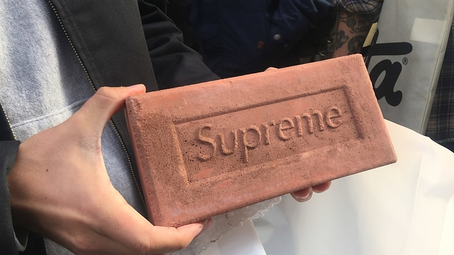
Incivility is Costly
Watching others being treated badly creates collateral damage
  30% less creative
  25% fewer ideas
Harvard Business Review, 2013; The Price of Incivility

Slide 101
Psychologic Safety
Psychological safety is the perception that a group environment is safe for inter-personal risk taking, exposing vulnerability and contributing perspectives without fear of negative consequences.
Individuals are not punished or humiliated for speaking up with ideas, questions, concerns, or mistakes.
Psychologic also safety encompasses feeling included at work.
Psychologic safety encompasses the belief that unique skills, talents and backgrounds are valued.
McClintock AH et al, Academic Medicine 2022, Vol 97, No 11s. S46-53

Slide 102
Psychologic Safety is Associated with Positive Behaviors
Alleviates fear and allows for more engagement in question asking
May improve responsiveness to feedback
Turnover of team members seems to be less
Lower rates of burnout
Increased intention to report medical errors
Better Doctor-Nurse Communication

Slide 103
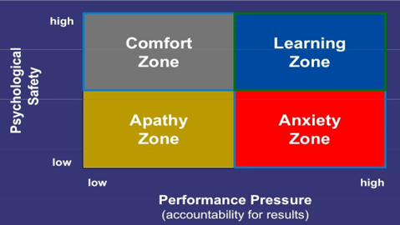
Psychologic Safety and Learning
Reproduced with Permission from Amy Edmondson

Slide 104
Improving Psychologic Safety
Individual Changes
Be Friendly (e.g., smile) Show vulnerability- admit and discuss mistakes Admit knowledge gaps, model learning new knowledge Learn the names of everyone on the team Invite input from learners at all levels Respond respectfully to questions Listen Thank people | Use Open-Ended questions and not one “right”answer questions Acknowledge what is “right” about answers Be humble Act curious, ask questions Learn something about your team members Include learners in care/discussions Set expectations for want you expect of team members Assume positive intent (and don’t assume) Respect people’s time
Team Changes
Increase the duration of rotations Decrease transitions of learners Use team activities to socialize Implement interprofessional team training | Minimize attending (or supervisor) transitions Incorporate time to debrief about care Use a collaborative leadership style rather than authoritative leadership Co-localize patients (i.e. geographic rounding)
System Changes
Decrease work load Flatten team hierarchy, use 1st names Set clear expectations for physician and nurse behavior Use formal “high-stakes” summative assessment as little as possible Design teams and units as small as possible Work to minimize turn-over of staff Reward speaking up | Decrease work hours Incorporate leadership rounds Hold people accountable for bad behavior Counsel and when unsuccessful remove educators and leaders who demean, belittle, berate or yell at others Replace high-stakes summative assessments with more regular low-stakes formative assessment Colocalize patients (i.e. geographic rounding)

Slide 105

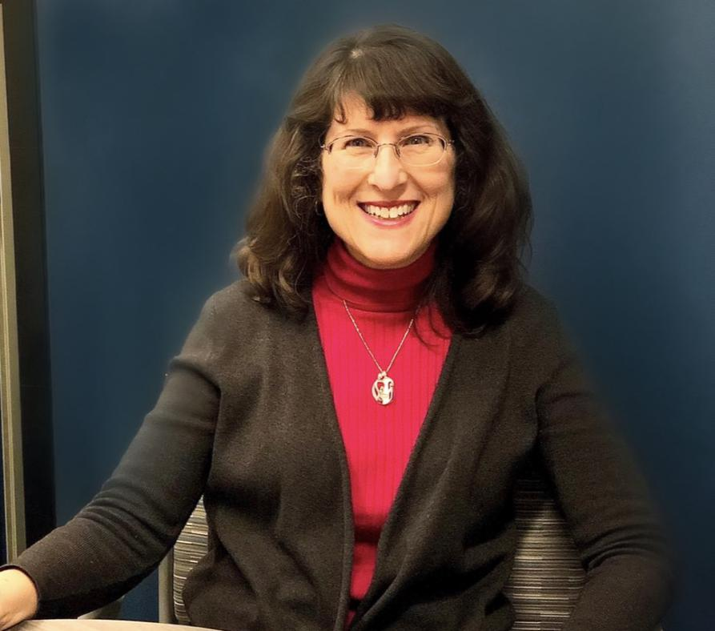
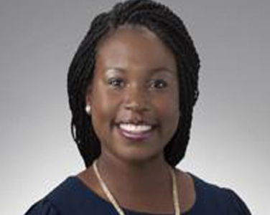
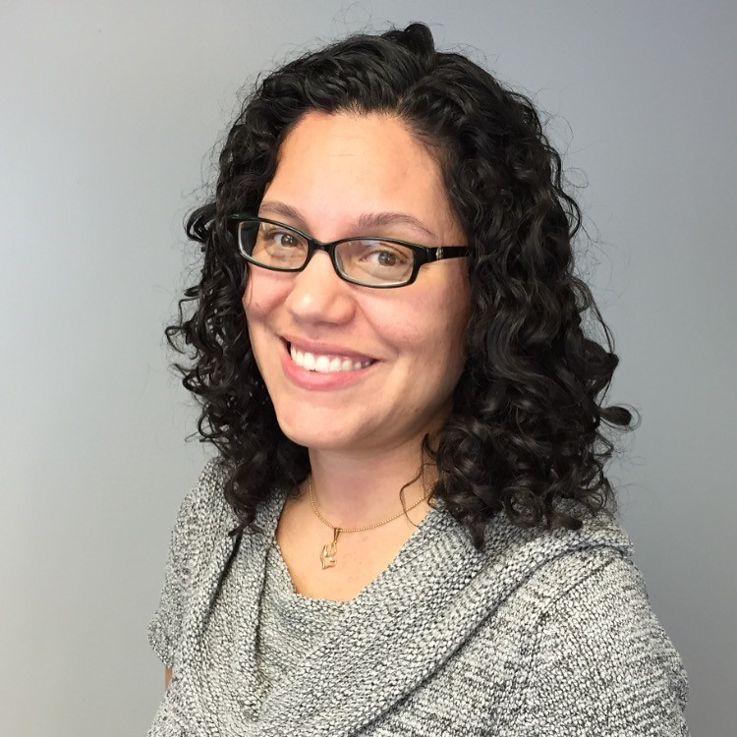
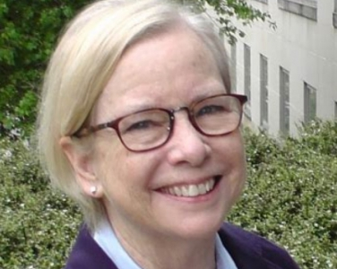
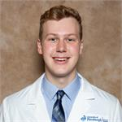
What if there’s a problem?
Advisory
Deans
Clerkship
Directors
Ombuds
Listening
Rounds
CC reps

Slide 106
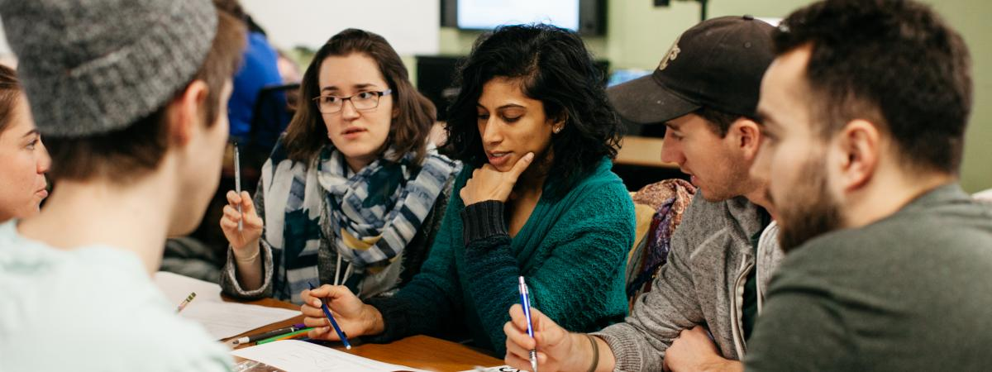
We pledge…
The learning environment at UPSOM/UPMC should consist of groups that are supportive, inclusive, and professional; that foster teamwork and stimulate critical thinking in medical students; and that are guided by competent educators who help students develop knowledge, skills, and attitudes essential in competent physicians.

Slide 107
Summary
  Incivility is common in medical school learning environments
  Civility and psychological safety are essential to individual and organizational success
  Individual, team, and systems interventions can improve civility and safety—and we’re all responsible

Slide 108

Facilitated
Discussion

Slide 109
Prompt #1:
Remember our scenario back in the OR, with the resident embarrassing the medical student for slow closure, and suggesting that surgery isn’t the right career path? Imagine you’re the attending who hears about this later from a staff member present
What can be done at this point?
How might you prevent this in the future?

Slide 110
Prompt #2:
A group of colleagues come to you to complain about division faculty meetings. They feel that the chief frequently lets the meetings degenerate into finger pointing, yelling, and profanity—generally targeting junior faculty. No one wants to go, and people are frustrated and scared.
What can be done?

Slide 111
Brainstorming
What else would help YOU to better create environments of civility/safety in your environment?

Slide 112
Change
What one ACTION will you take after this session to improve civility in our environment?

Slide 113
Break
Please welcome the
PalPITTations

Slide 114
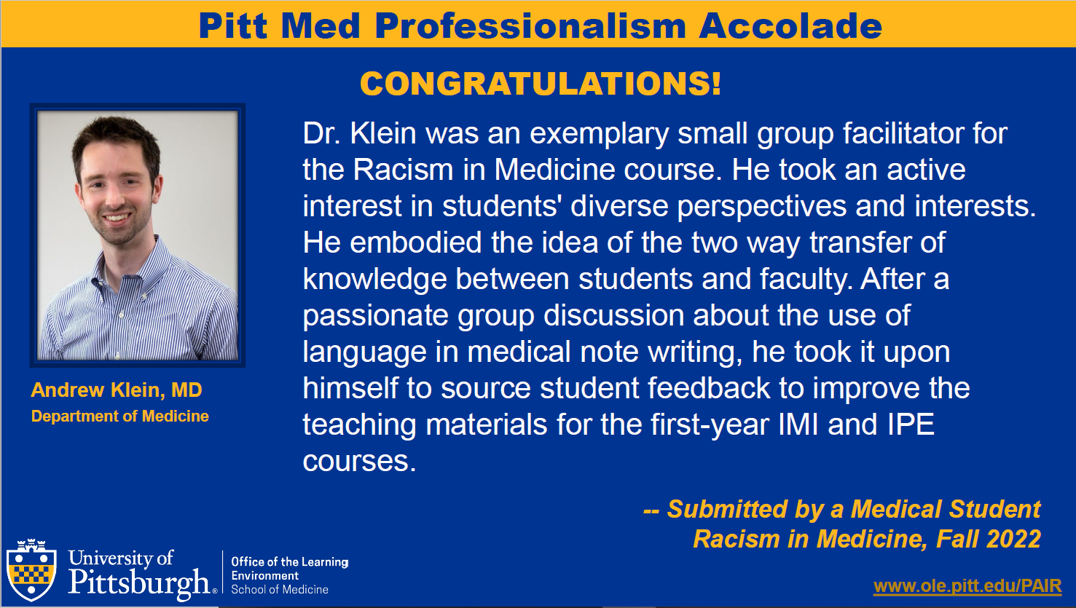

Slide 115
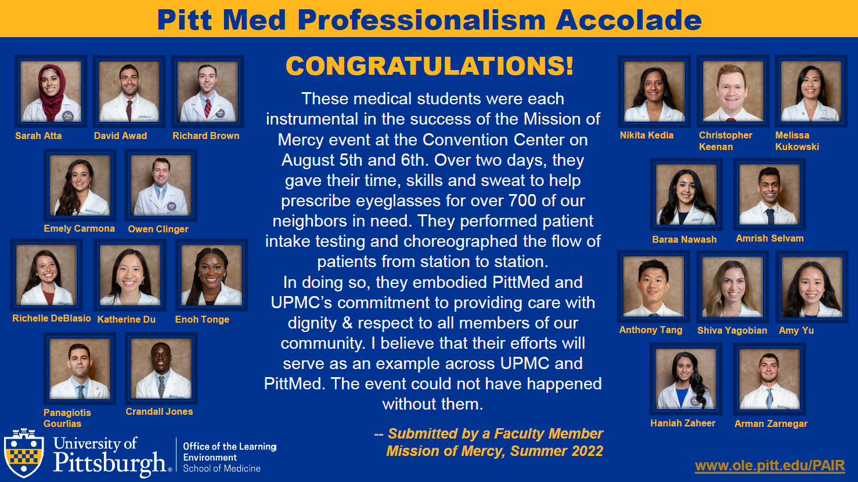

Slide 116
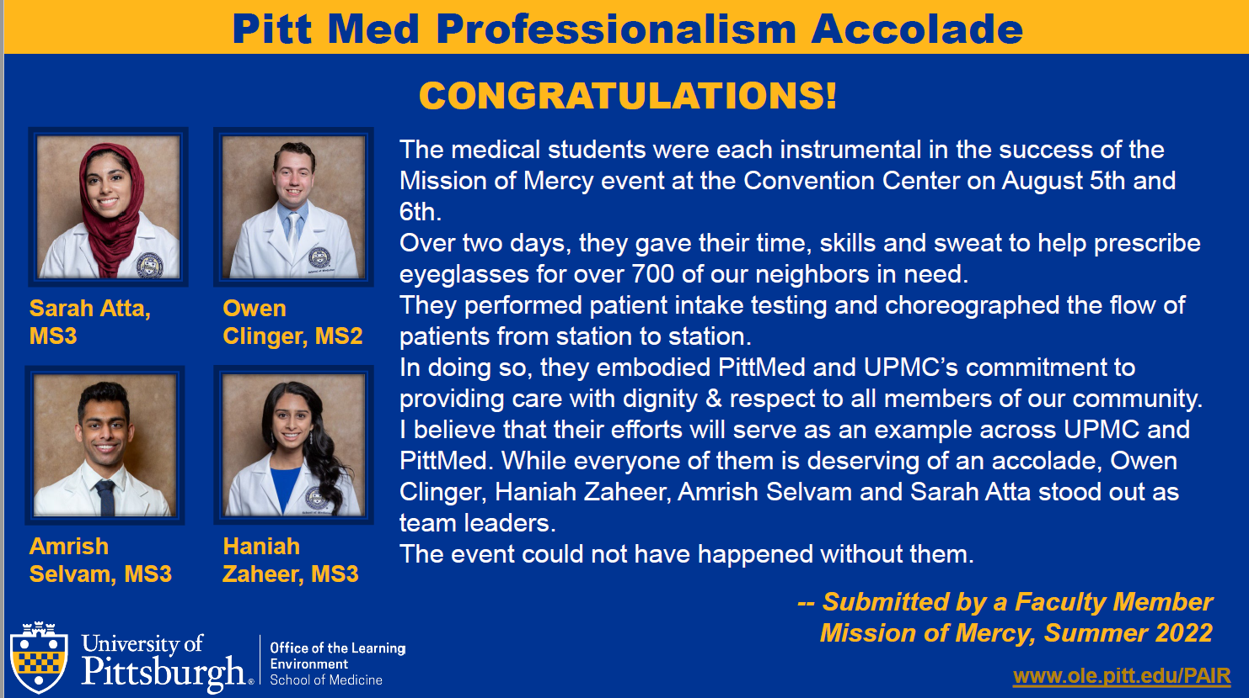

Slide 117
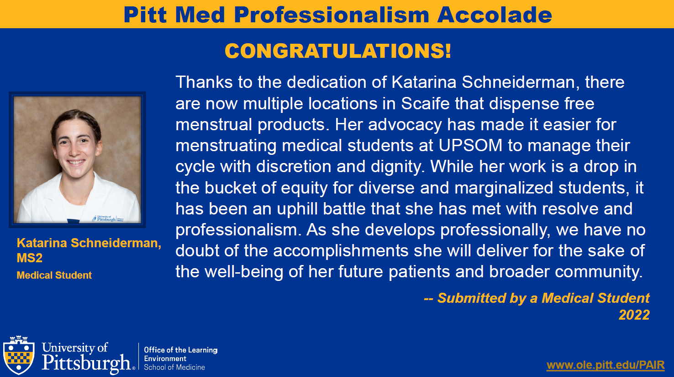

Slide 118
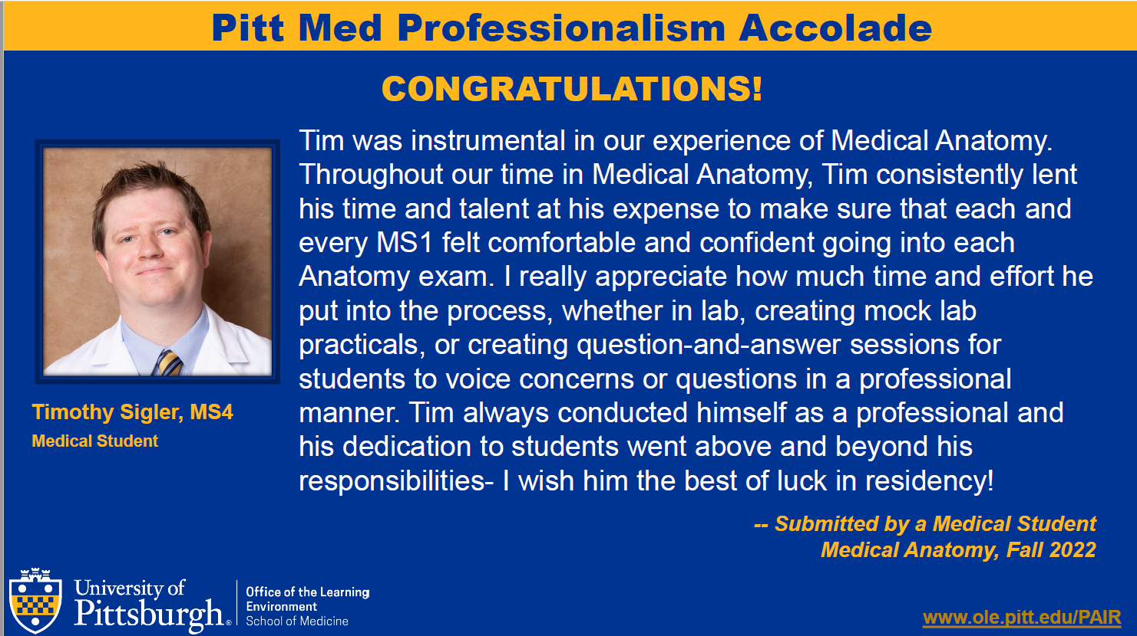

Slide 119
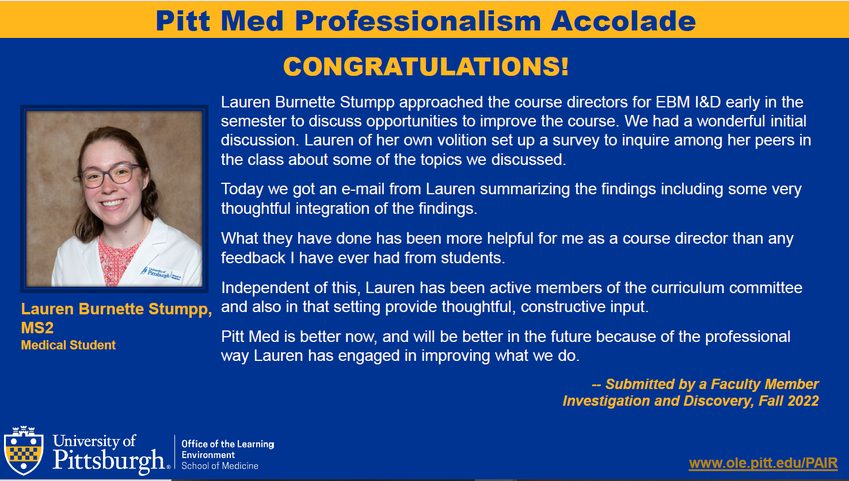

Slide 120
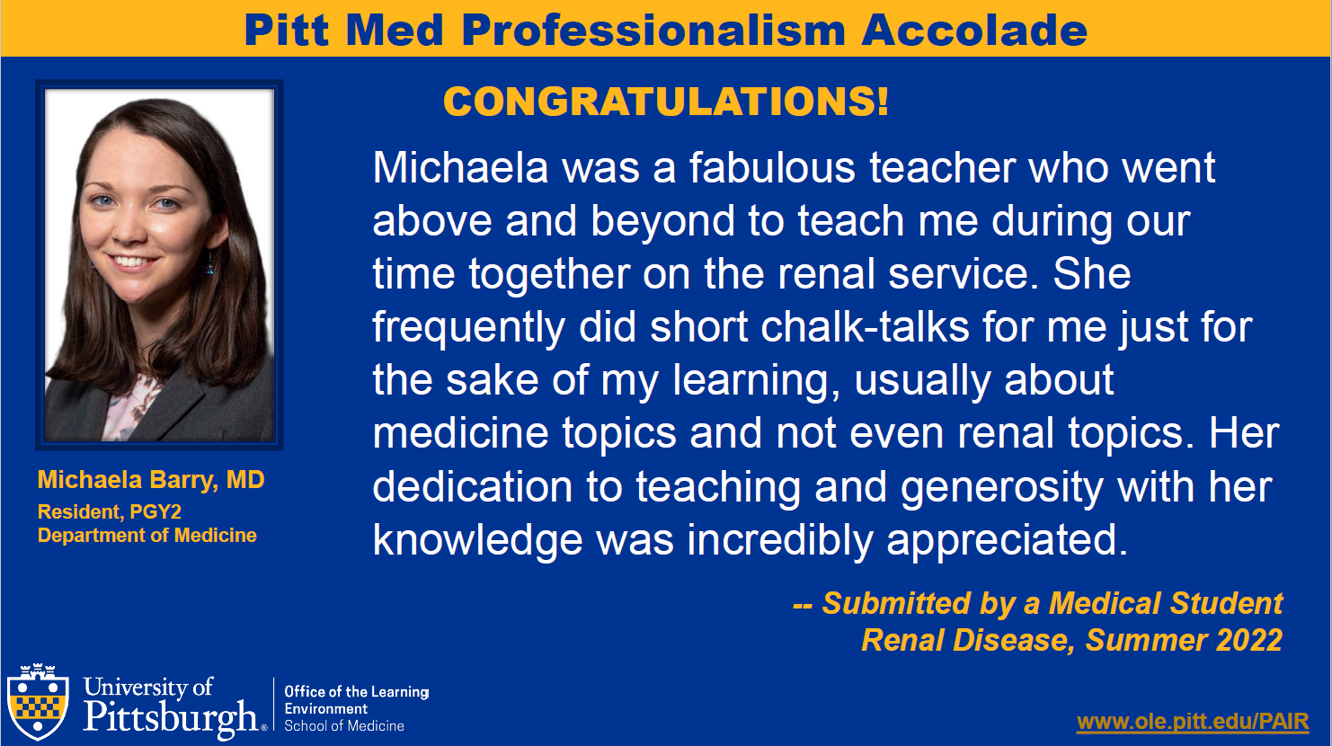

Slide 121
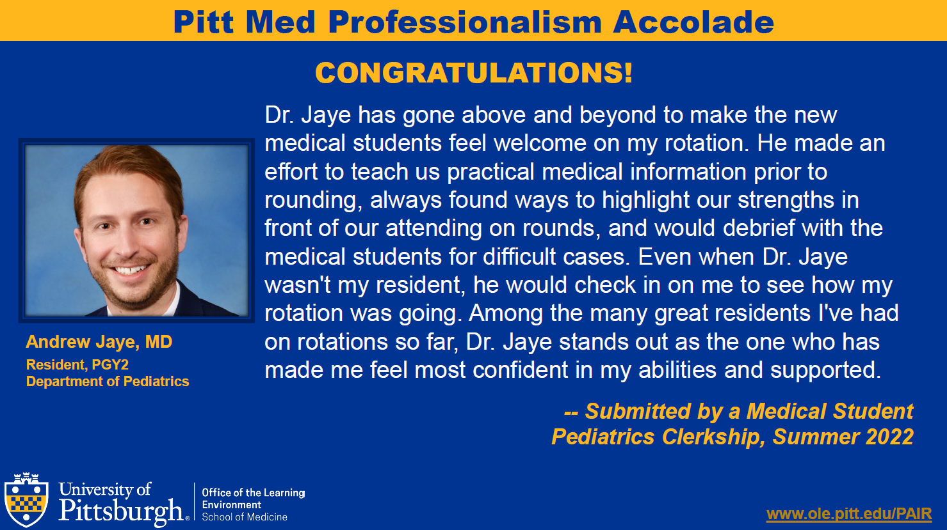

Slide 122
