Slide 1

Curriculum Reform Update
Curriculum Committee Q3 report
Mike elnicki and peter drain
Monday 16 august 2021

Slide 2

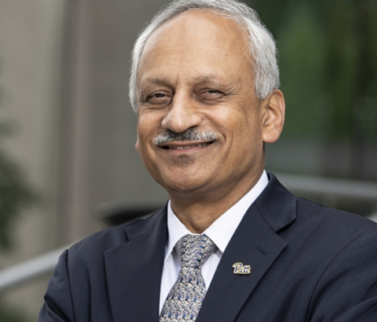
PittMed People are…
Healers
Activists
Innovators
Leaders
Context/Background
Goals/Objectives
Task Force Structure & Work
Current Recommendations
Future Planning

Slide 3
The Process
Phase Goal Dates
1 Exploratory 9/19-4/20
2 Planning 10/20-12/21
3 Formation 1/22-12/22
4 Implement 1/23-7/23
5 Rollout 8/2023
Context/Background
Goals/Objectives
Task Force Structure & Work
Current Recommendations
Future Planning

Slide 4
task force structure & people
Steering Subcommittee
Mike Elnicki, MD
Peter Drain, PhD
Foundations Subcommittee
Alexandra Clark, MD
Lisa Borghesi, PhD
Clerkships & Beyond Subcommittee
Chris Schott, MD, MS, RDMS, FACEP
John Szymusiak, MD, MS, FAAP
Humberto Trejo-Bittar, MD
Learning Assessment & Program Evaluation Subcommittee
Greg Null, MA
John Maier, PhD, MD
Student Advisory Subcommittee
Jonathan Perkins, MS4
Rachel Fogel, MS3
https://www.omed.pitt.edu/curriculum-reform/subcommittee-leadership
Context/Background
Goals/Objectives
Task Force Structure & Work
Current Recommendations
Future Planning

Slide 5
Timing two major curriculum components
“Foundations” 2023 MS1 Aug - MS2 Oct, ~15 mos
  Orientation week 8/7 MS1->
  Intro to being a physician 8/14->
  Anatomy Lab 8/21 - 9/1
  Keystone Fundamentals: cells & molecules, structure & function, defense & injury (~10 wks) 9/5 – 11/10
  Organ Systems Block 11/27 MS1 – 10/31 MS2
“Clerkships & Beyond” MS2 Jan–MS4 May, 30 mos
  Pre-Clerkship (2-4 wks) MS2 Jan
  Core Clerkships (~12 mos) MS2 Feb - MS3 Jan
  Beyond (16 mos) MS3 Feb -> MS4 May
Context/Background
Goals/Objectives
Task Force Structure & Work
Current Recommendations
Future Planning

Slide 6
major learning-teaching formats
  Case-based (scenario and actual patient)
  Pre-class: SDL/didactics, priming, formative assessments fed-
  forward to facilitators for orchestrating workshops
  In-class: active small group workshops
  Post-class option - reflection, collaboration, formative assessment
  Longitudinal clinical & itinerant basic science dedicated educators
  Foundations implementing the dedicated educators
  OMEd to develop, train and support dedicated educators
  Learn From Anywhere support when it works well for the pedagogy
Context/Background
Goals/Objectives
Task Force Structure & Work
Current Recommendations
Future Planning

Slide 7
“FLEX Weeks”
  Total length 1 week
  No required activities during flex weeks
  Scholarly activity, self-care, remediation, weddings, etc.
  In Foundations and Clerkships & Beyond
  Midstream and at natural breaks between components
  See frequency and positions in proposed maps following
Context/Background
Goals/Objectives
Task Force Structure & Work
Current Recommendations
Future Planning

Slide 8
MS1-MS2 Summer Break
Total Length: 10 weeks
  Opting into DSRP: 8 weeks DSRP + 2 weeks summer break
  Not opting into DSRP: 10 weeks summer break
  ~ mid-May through July
Context/Background
Goals/Objectives
Task Force Structure & Work
Current Recommendations
Future Planning

Slide 9
Step 1 Dedicated time ~ 1 month
  MS2 Dec …
  Dec would follow Flex week + Thanksgiving week off
  Have to pass Step 1 to go onto next clerkship
Step 2 CK Dedicated time – 1 MONTH
  MS3, after core clerkships and before ERAS
  Could be a floating flex month students choose individually
  Higher stakes – 2CK score differentiator
Context/Background
Goals/Objectives
Task Force Structure & Work
Current Recommendations
Future Planning

Slide 10
New Curriculum Blocks
Tight sequence of required inter-related contiguous courses, clerkships, activities
Doctoring Block (MS1-2)
      Introduction to Being a Physician intro week
      Intro to Patient Care
      Patient, Physician, and Society
Keystone Fundamentals Block (MS1)
Evidence & Discovery Block (MS1-4)
      EBM Fundamentals & Applied (required)
      DSRP (MS1-2 summer; optional)
      EBM Investigation and Discovery (required)
      LRP (required)
Organ Systems Block (MS1-2)
Core-Clerkships Block (MS2-3)
Context/Background
Goals/Objectives
Task Force Structure & Work
Current Recommendations
Future Planning

Slide 11
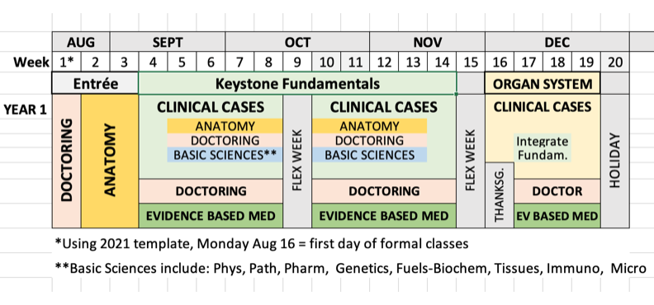
Foundations details developing MS1 Fall
Context/Background
Goals/Objectives
Task Force Structure & Work
Current Recommendations
Future Planning

Slide 12
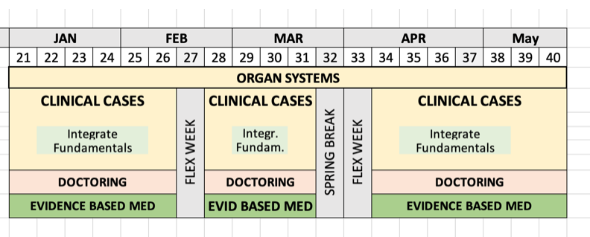
Foundations details developing MS1 Spring
Context/Background
Goals/Objectives
Task Force Structure & Work
Current Recommendations
Future Planning

Slide 13
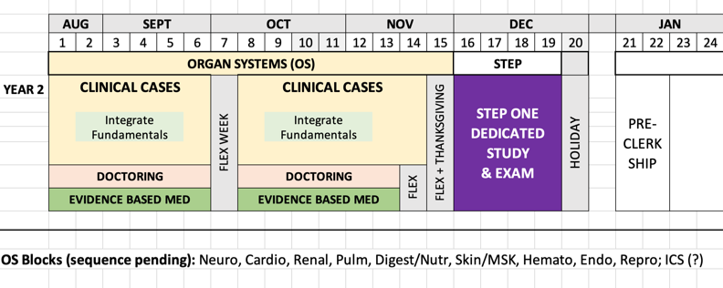
Foundations details developing MS2 FALL
Context/Background
Goals/Objectives
Task Force Structure & Work
Current Recommendations
Future Planning
  Student Advisory recommends Clerkships begin no later than mid Jan MS2

Slide 14
clerkship & beyond details developing
Clerkships
  Pre-Clerkship MS2 Jan (2-4wks)
  Core Clerkships MS2 Feb – MS3 Jan (12mos)
  Beyond
  MS3 Feb – MS4 May (16 months)
  Acting Internships
  Working for a Longitudinal Integrated Clerkship (LIC)
  Beyond Electives: taste 2wk, entrez 4wk, intern 4wk levels
Context/Background
Goals/Objectives
Task Force Structure & Work
Current Recommendations
Future Planning

Slide 15
recommendations – “Threads”
The main goal of each Thread is to ensure integration of critical connections by identifying and developing them through curricular components to achieve the vision of what a Pitt physician should be once graduated from the MD program.
Context/Background
Goals/Objectives
Task Force Structure & Work
Current Recommendations
Future Planning

Slide 16
recommendations – “Thread guides”
Timing: Approximately every two weeks of Foundations a different Thread will have the opportunity (up to two hours in-person time) to be taught. Threading will be done in situ through Core Clerkships and Beyond.
Guide: Thread leaders will each write a guide (1-2 pages) with sections:
Thread Title
Thread Theme(s) and competency goals for graduating Pitt MD’s
Thread Lead and Co-Lead (for continuity and improvements have two Leads)
List of Curricular Components (course and clerkship titles and their directors participating (bilaterally) in Thread with LOs identified that Thread inter-connects and develops in curriculum
Teaching Modules, if used by the Thread, including schedule across curriculum
Assessment formats and grading policy, if used by the Thread
Annual Thread Review Format - to ensure optimal integration and continuing improvement in the new curriculum, OMEd will review with Thread Leads their Thread annually.
Thread Handbook: Thread Guides will be up to date and in
one place in a ‘Thread Handbook’ online for students,
Directors, staff, etc., to access anytime, anywhere.
Context/Background
Goals/Objectives
Task Force Structure & Work
Current Recommendations
Future Planning

Slide 17
recommendations – “Tracks”
Humberto is leading the group with AOC Directors framing out Tracks
  Tracks will be optional, like minors in college – Dean Thompson
  Student Advisory SC recommends keeping LRP separate
  Tracks incorporating AOCs, other activities, scholarly product
  Student can sample for first year and take up to two tracks
  Not chaotic - uniform requirements (e.g., 2 yrs) across all Tracks
  Recommend Track completed be highlighted in MSPE letter
Context/Background
Goals/Objectives
Task Force Structure & Work
Current Recommendations
Future Planning

Slide 18
Example TRACKS – HAIL PITT MED
  Primary Care/Underserved/Activist/Advocacy Track: culmination of this track requires generating a scholarly project in primary care/underserved populations and/or advocacy
  Innovator Track: culmination of this track requires generating a scholarly project leading to a new patent/device, lunch a start-up, write a white paper, etc
  Administrator/Leader Track: culmination of this track requires generating a scholarly project in administration, involvement in QA/QC projects, creation of a business plan/proposal, new policies, etc
  Many Additional Tracks: being added in Q4, including from extant AOCs
Context/Background
Goals/Objectives
Task Force Structure & Work
Current Recommendations
Future Planning

Slide 19
IDEA competition
  10 finalist Ideas are being circulated among CR subcommittees
  For example, a confluence of a winning IDEA Competition entry from Students & opportunity pointed out by Dean Shekhar:
  Future centerpiece of medical education & training at Pitt Medicine
  – AI and Computational Medicine –
  CC Task Force on it now
Context/Background
Goals/Objectives
Task Force Structure & Work
Current Recommendations
Future Planning

Slide 20
Learning Assessment & Program Evaluation
Learning Assessment
  Learning objectives are critical for course and clerkship directors to integrate materials, activities, assessments
  Group on remediation being formed
  Progress testing approach developing to improve student learning and development
CR Process Evaluation
  Measure before we start – AY21-22: fall determine measures; spring, gather the data; Mandatory surveys; Focus groups/professional qualitative research
  Measure as we go – AY23-24 fall new curriculum implementation, track measurements
Program Evaluation
  Planning for continuous Program Evaluation
Context/Background
Goals/Objectives
Task Force Structure & Work
Current Recommendations
Future Planning

Slide 21
Summary
Thanks to project manager Michelle Sergent
Thanks to curriculum MAPPER Katie Maietta

Slide 22
THANKS to ALL SC MEMBERS for the heavy lifting
DEAN’s ASPIRATION PITT MED becomes A Top ten MD PROGRAM grEat ideas ALWAYS WELCOME – CONTACT US
  Michelle Sergent, MPH mls124@pitt.edu
  Jason Rosenstock, MD jasonr@pitt.edu
  Peter Drain, PhD drain@pitt.edu
  Mike Elnicki, MD dme101@pitt.edu
  or through the CR website: https://www.omed.pitt.edu/curriculum-reform/curriculum-reform-questions-suggestions
Context/Background
Goals/Objectives
Task Force Structure & Work
Current Recommendations
Future Planning

