Slide 1
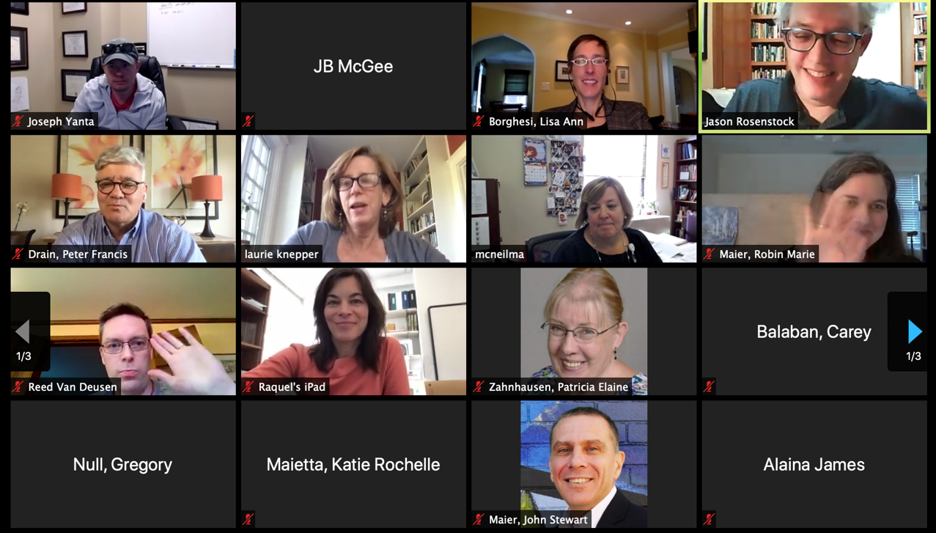
Educational Technology to Facilitate Remote Teaching and Learning
June 15, 2020

Slide 2
Outline (not for presentation)
COVID-19 silver lining – curriculum renewal
Goals of remote teaching & learning – quality for posterity, reliability for ephemeral teaching
SOM Guidelines – 4 teaching settings
Examples of teaching remotely
Audio quality
Other tips – lighting, presentation skills, other hardware aids

Slide 3
Teaching & Learning in the time of COVID
Remote teaching and learning – not new, and not going away
Effective remote learning is learner-focused
Easy to use
Consistent
Active with clear instructions
Frequent feedback
Today’s review – official TECH GUIDELINES for year 1 & 2 courses; advice for clerkships
Notes:
Didn’t want it to happen this way
Good precursor to curriculum renewal

Slide 4
The Guidelines
Find on omed.pitt.edu and navigator.pitt.edu
Just guidelines, not rules, and not static
Leverages available technologies and what we can best support
Built on “weeks” of experience - Cynthia, Jason, Greg Wagner, Jane Alexander, others
Take home message: Contact your Curriculum Specialists
Maria Garcia mcg68@pitt.edu - for pre-clinical courses
Denise Downs gjw20@pitt.edu – for clinical clerkships

Slide 5
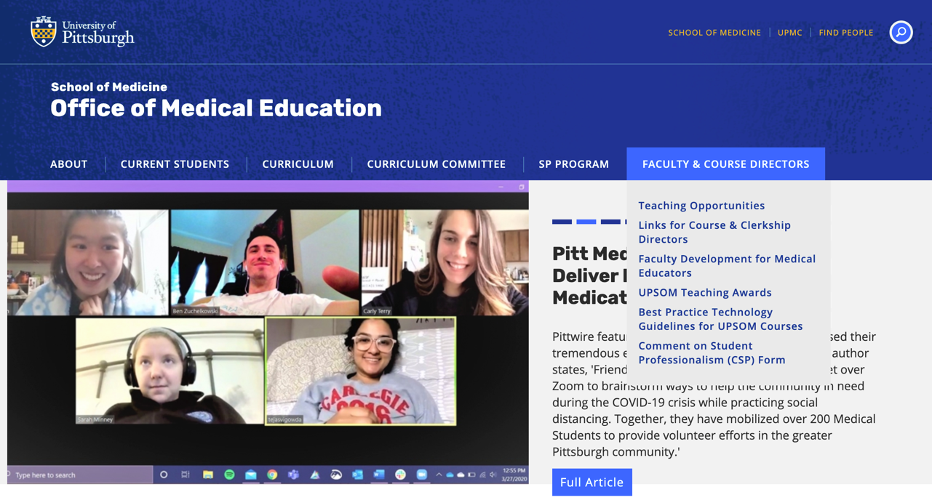
omed.pitt.edu

Slide 6
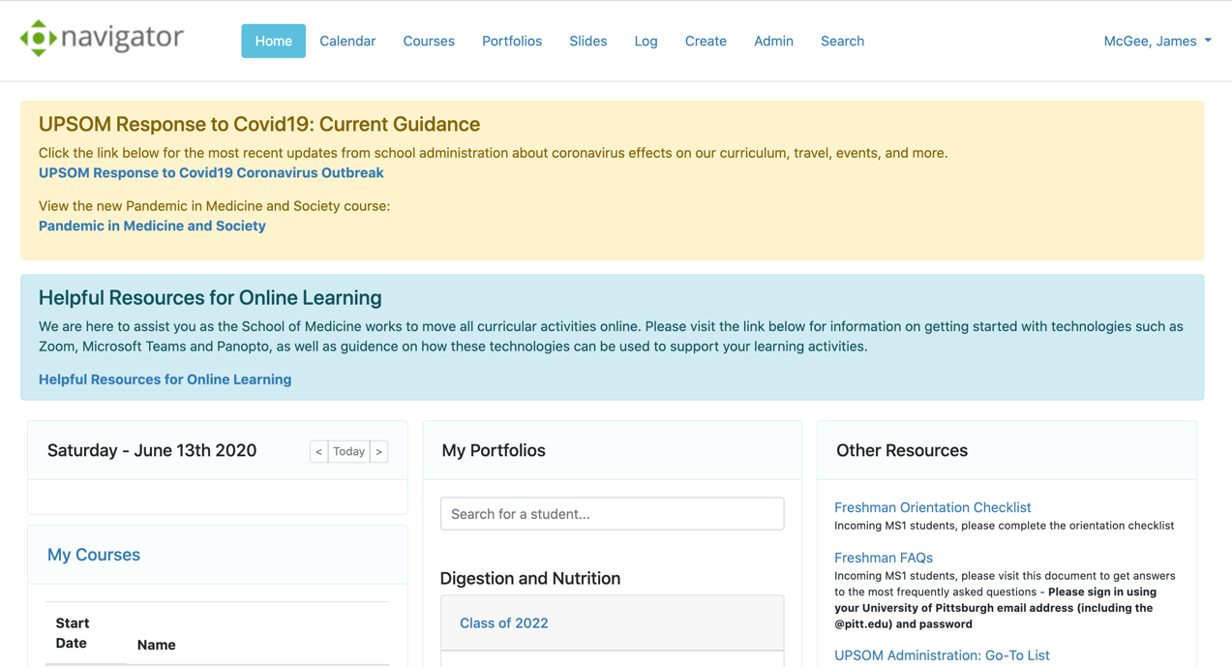
navigator.pitt.edu

Slide 7
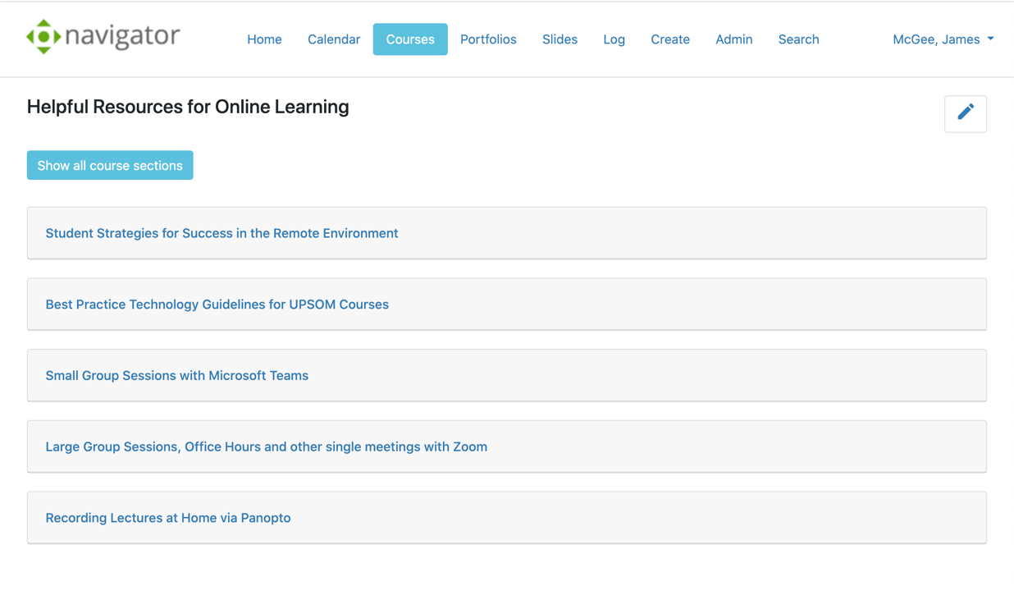
navigator.pitt.edu

Slide 8
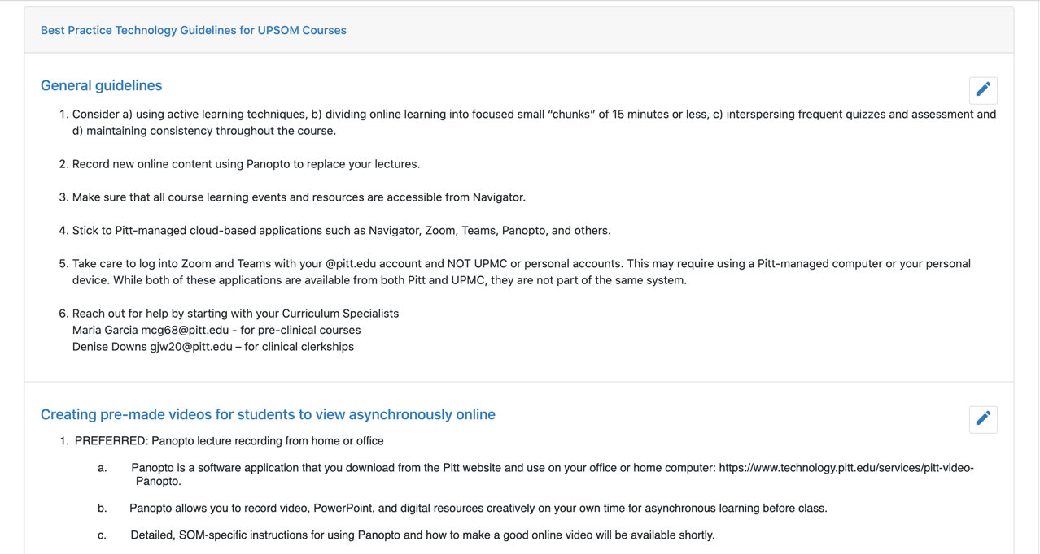

Slide 9
Four teaching environments
Asynchronous, pre-recorded, online learning modules | PanOpto
Live and hybrid teaching | Zoom
Small group learning | Teams
Office hours | Zoom

Slide 10
LabEdu@pitt.edu
CURRICULUM SPECIALISTS
OMED
Online modules
(Navigator)
YouTube videos
Surveys
(Poll Everywhere)
Self assessment quizzes
(Navigator)
Recorded lectures
(PanOpto)
Hybrid lectures
(Zoom, Owl)
Hybrid labs
(Zoom, Custom)
Formative assessment
(Navigator)
Remote lectures
(Zoom)
Remote small groups
(Teams)

Slide 11
Pre-recorded modules = PanOpto
PREFERRED: PanOpto – desktop software you download from the Pitt PanOpto website (non-UPMC computers)
Records your slides with voice-over & video from webcam
Stored on Pitt media servers with links from Navigator
Can edit and reuse next year
Work with Curriculum Specialist to post event links in Navigator
https://www.technology.pitt.edu/services/pitt-video-Panopto

Slide 12
Live lecture/event = Zoom
PREFERRED: Zoom
Schedule through your Curriculum Specialist
Pitt allows Zoom, UPMC does not
Can be hybrid – some students in classroom, some at home
Tell students if real-time attendance is expected
White board, polling, shared screen
Can record and is copied to Pitt PanOpto and accessed from Navigator
Avoid: Teams, **can’t use UPMC Teams account; students can’t access
Avoid: Social media sites (YouTube); need a copy on Pitt platform
https://www.technology.pitt.edu/services/zoom-video-conferencing
Notes:
Security has improved but not perfect
Get latest version with enhanced security

Slide 13
Small Group Sessions = Teams
PREFERRED: Teams
Curriculum specialists will work with Lab to schedule
Easier to set up than Zoom
Acceptable: Zoom small group (breakout rooms)

Slide 14
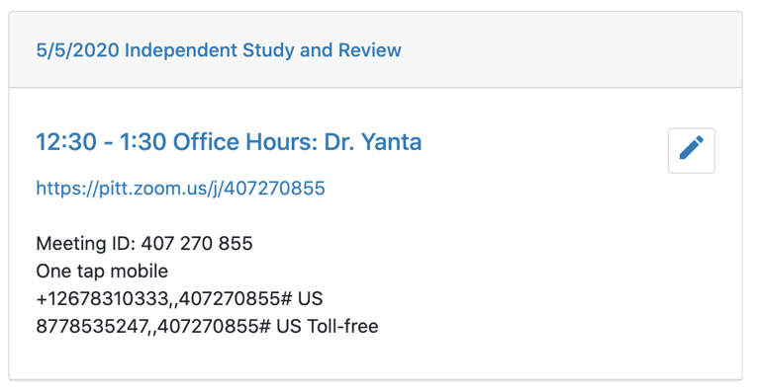
Office Hours = Zoom meeting
Use one Zoom recurring meeting
Enable “waiting room”
Set “Only authenticated users can join”
Add to course Navigator events

Slide 15
Lots of help available for teaching remotely
Curriculum Specialists can direct you
Loaner laptops, microphones available
Use classroom and upcoming dedicated studio
Some general tips
Audio
Lighting
Video

Slide 16
Content is still king – good production helps
For pre-recorded lectures (PanOpto)
Keep it short, 10-15 minutes
Scripted > extemporaneous
Bookend slides with a video clip of you
You are not THAT interesting, less-so online
Add whiteboard, quizzes, external animation and video

Slide 17
Keep lights, window on your face and not behind you

Slide 18
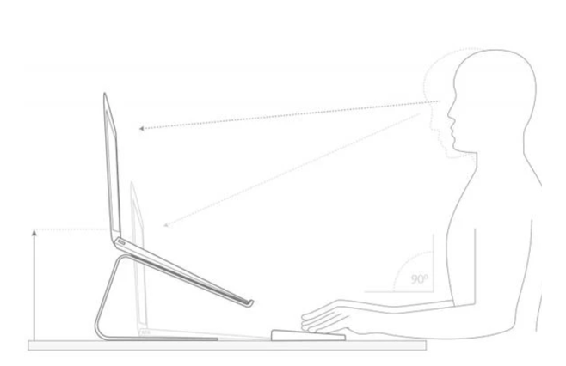
Prop laptop up to align camera at eye level

Slide 20
Online teaching tips
Tablet device if using whiteboard
2nd camera person – lab, active
Mobile phones have great video cameras
Live Zoom/Team sessions – Enlist a “helper” to manage chat, multimedia, button pushing

Slide 21
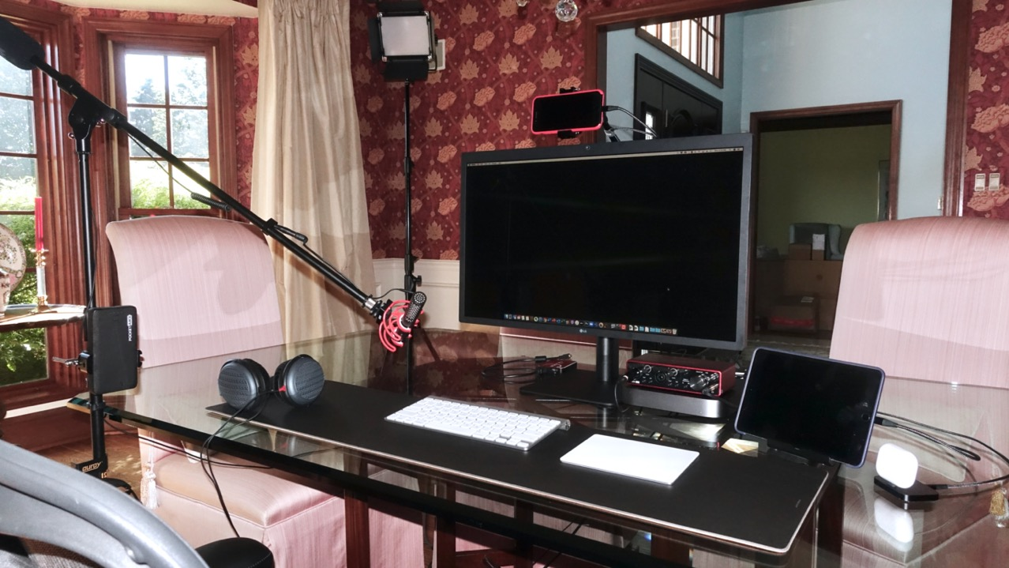

Slide 22
Final Suggestions for Remote Teaching
This is new for the learners too
Be clear when assigning online work - calling it “homework” says a lot
How long will it take? How will they know they’re done?
Assess competency and give feedback
Human interaction is valued more than ever
Feel free to blame technical and production glitches on COVID

Slide 23
Greg Wagner gjw20@pitt.edu – for technical help, Zoom, Teams, Panopto
Lab for Educational Technology labedu@pitt.edu – for Navigator, learning technologies
Cynthia Lance-Jones clancej+@pitt.edu – for curriculum design, learning methods
Pitt technology resources: http://technology.pitt.edu
Pitt Panopto website: https://www.technology.pitt.edu/services/pitt-video-Panopto
Panopto recording tutorials here.
Zoom tutorial on YouTube here.
Teams and Zoom tutorial on LinkedIn Learning (Pitt login required)
Zoom tips: https://www.youtube.com/watch?v=UNxhkq9jjVo
Academy of Medical Educators “Best Practices for Online Learning” https://pitt.hosted.Panopto.com/Panopto/Pages/Viewer.aspx?id=1f0b3d9d-a1c2-4d05-98e4-abab0100637d
Notes:
Thank you to Cynthia, Maria Norman

