Slide 1
Curriculum Reform at the University of Pittsburgh School of Medicine
Jason Rosenstock, MD

Slide 2
Why change?
Growth opportunities raised by LCME self-study, student suggestions, metrics:
Update pedagogy with newest, best practices for modern learners
Thread content across curriculum to address content gaps
Make the Foundations phase (MS1-2) tighter, better integrated/preparatory
Enhance flexibility of clinical phase to allow for more exploration
Right-size curricular components
Improve assessment system quality and consistency
Better prepare the next generations of physicians for their ultimate practice

Slide 3
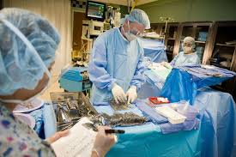
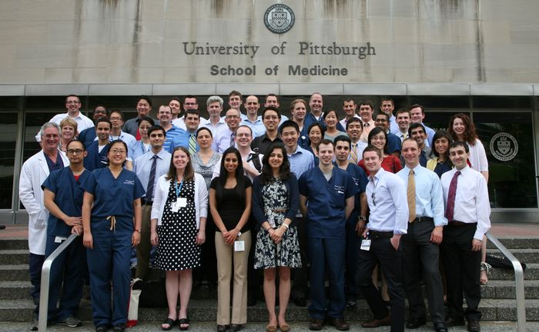
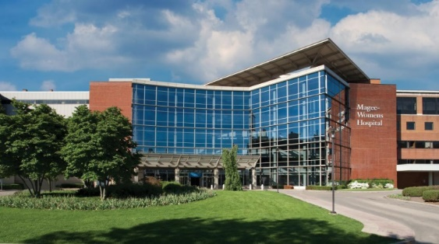

Slide 4
Curriculum Reform
Phase 1
EXPLORATORY
Fall
2019
2/20
Phase 2
PLANNING
Phase 3
FORMATION
10/20
12/21
Phase 4
IMPLEMENTATION
1/22
12/22
Phase 5
ROLLOUT
1/23
7/23
Fall 2023
Three Rivers Curriculum

Slide 5
Phase | Title | Tasks | Deliverables
1 | Exploration | Should we change? What should change look like? | Principles: more frequent assessment, more active learning
2 | Planning | Teaching formats Timing Policies Integration approaches | Plans: weekly formative quizzes, 6wk clerkships, case-based, SDH/IPE community project, organ-based approach
3 | Formation | Daily schedules Materials Leaders Nuts and bolts | Specifics: clinical skills qWed am, anatomy during 6/8 OS courses, thread leads for 4 topics, curated ANKI decks built
4 | Implementation | Legacy planning Scheduling and registration Staffing Technology | Making it Happen: updating AMP-UP and Navigator, hiring segment admins, coordinating legacy overlap, communicating changes
5 | Rollout | Operations QI Monitoring | Making Sure it Works: regular checks and feedback, tracking outcomes, changing things that don’t work

Slide 6
Project Management
CR-2
Steering Committee
Foundations
Clerkships & Beyond
Learning Assessment &
Program Evaluation
Student Advisory

Slide 7
CR-2: Subcommittee Leadership
Subcommittee | Leaders
Steering | Peter Drain Michael Elnicki
Foundations | Lisa Borghesi Alexandra Clark
Clerkships & Beyond | Chris Schott John Szymuziak
Learning Assessment & Program Evaluation | John Maier Greg Null
Student Advisory | Rachel Fogel Jonathan Perkins

Slide 8
Overall
Musts
Shorten Foundations to 15mo (end by 12/31)
Retain Pass/Fail grading in Foundations
Retain capstone research project
Retain core clerkships: Medicine, Surgery, Peds, OB, Psych, Neuro
Require USMLE exam success for graduation
Support extracurricular, areas of concentration, professional enrichment courses

Slide 9
Idea Competition
In parallel, let’s try to get more CR ideas from the community
topics/themes, processes/approaches
students, faculty/staff

Slide 10
CR-2: Key Points
We’re really good but we want to be even better:
Better focus in Foundations segment (15mo), starting clerkships earlier
Better assessment frequency/quality, integration
Better use of newer educational technology where appropriate
Better ties to other health professions (interprofessional education)
Better focus on social medicine, determinants, anti-racism, LGBTQ+

